Slide 1



Graduation IN Informatics engineering
Backend Node.js, Express, MySQL, Angular
■ Course Unit: Project III
Luís Alonso 17506
■ Coordinator: Prof. Doctor Jorge Ribeiro
Instituto Politécnico de Viana do Castelo
Escola Superior de Tecnologia e Gestão
www.ipvc.pt
School Year: 2020/2021

Slide 2
Graduation IN Informatics engineering
■ Summary
Project III
1. Introduction and Objectives
2. Technologies, Tools, Frameworks
2.1 Node
2.2 Express
2.3 MySQL
2.4 CORS
2.5 BodyParser
2.6 Sequelize
2.7 JWT
2.8 Bcryptjs
3. Diagrams V1
3.1 Application Architecture
3.2 Flow for Signup & Login with JWT Authentication
3.3 API EndPoint’s
3.4 Tables created in the DataBase
4. Node Implementation V1
5. Postman Testing V1
6. AngularImplementation V1
7. Implementation V2
7.1 Use Case Diagram
7.2 EER Model
7.3 Implementation of Node
8. Implementation of Angular
9. GitHub Repository
10. Conclusion and Future Work
11. Bibliography and Web References
@2020/2021 – Luis Alonso 17506– Backend Node.js, Express, MySQL
- 2 -

Slide 3
Graduation IN Informatics engineering
Introduction and Objectives
Project III
In this phase i will implent the authentication system for the Project, using JsonWebTokens.
I will create a REST API using Node.js, Express and MySQL.
I will also use:
CORS Body-Parser,
Sequelize,
JsonWebToken,
Bcryptjs.
@2020/2021 – Luis Alonso 17506– Backend Node.js, Express, MySQL
- 3 -

Slide 4

Graduation IN Informatics engineering
2.1 Technologies, Tools, Frameworks
Project III
Node.js is a free, open-sourced, cross-platform JavaScript run-time environment that lets developers write command line tools and server-side scripts outside of a browser.
@2020/2021 – Luis Alonso 17506– Backend Node.js, Express, MySQL
- 4 -

Slide 5

Graduation IN Informatics engineering
2.2 Technologies, Tools, Frameworks
Project III
ExpressJS is a web application framework that provides you with a simple API to build websites, web apps and back ends. With ExpressJS, you need not worry about low level protocols, processes, etc.
@2020/2021 – Luis Alonso 17506– Backend Node.js, Express, MySQL
- 5 -

Slide 6

Graduation IN Informatics engineering
2.3 Technologies, Tools, Frameworks
Project III
MySQL is an Oracle-backed open source relational database management system (RDBMS) based on Structured Query Language (SQL). MySQL runs on virtually all platforms, including Linux, UNIX and Windows. Although it can be used in a wide range of applications, MySQL is most often associated with web applications and online publishing.
@2020/2021 – Luis Alonso 17506– Backend Node.js, Express, MySQL
- 6 -

Slide 7
Graduation IN Informatics engineering
2.4 Technologies, Tools, Frameworks
Project III
Cross-Origin Resource Sharing (CORS)
Cross-Origin Resource Sharing (CORS) is a mechanism that uses additional HTTP headers to tell a browser to let a web application running at one origin (domain) have permission to access selected resources from a server at a different origin. A web application executes a cross-origin HTTP request when it requests a resource that has a different origin (domain, protocol, and port) than its own origin.
@2020/2021 – Luis Alonso 17506– Backend Node.js, Express, MySQL
- 7 -

Slide 8
Graduation IN Informatics engineering
2.5 Technologies, Tools, Frameworks
Project III
CORS BodyParser
Parse incoming request bodies in a middleware before your handlers, available under the req.body property.
@2020/2021 – Luis Alonso 17506– Backend Node.js, Express, MySQL
- 8 -

Slide 9

Graduation IN Informatics engineering
2.6 Technologies, Tools, Frameworks
Project III
Sequelize is a promise-based Node.js ORM for Postgres, MySQL, MariaDB, SQLite and Microsoft SQL Server. It features solid transaction support, relations, eager and lazy loading, read replication and more.
@2020/2021 – Luis Alonso 17506– Backend Node.js, Express, MySQL
- 9 -

Slide 10

Graduation IN Informatics engineering
2.7 Technologies, Tools, Frameworks
Project III
JsonWebToken
JSON Web Token (JWT) is an open standard (RFC 7519) that defines a compact and self-contained way for securely transmitting information between parties as a JSON object. This information can be verified and trusted because it is digitally signed. JWTs can be signed using a secret (with the HMAC algorithm) or a public/private key pair using RSA or ECDSA.
In this Project the secret will be: “Eindhoven”.
@2020/2021 – Luis Alonso 17506– Backend Node.js, Express, MySQL
- 10 -

Slide 11

Graduation IN Informatics engineering
2.8 Technologies, Tools, Frameworks
Project III
BCrypt.js is a module used to encrypt the user credentials before storing them in the DataBase.
This way, we do not store users’ passwords in the database in its original form. Instead, a password is stored in a complex combination of text and unique characters; this is known as a password hash method.
@2020/2021 – Luis Alonso 17506– Backend Node.js, Express, MySQL
- 11 -

Slide 12
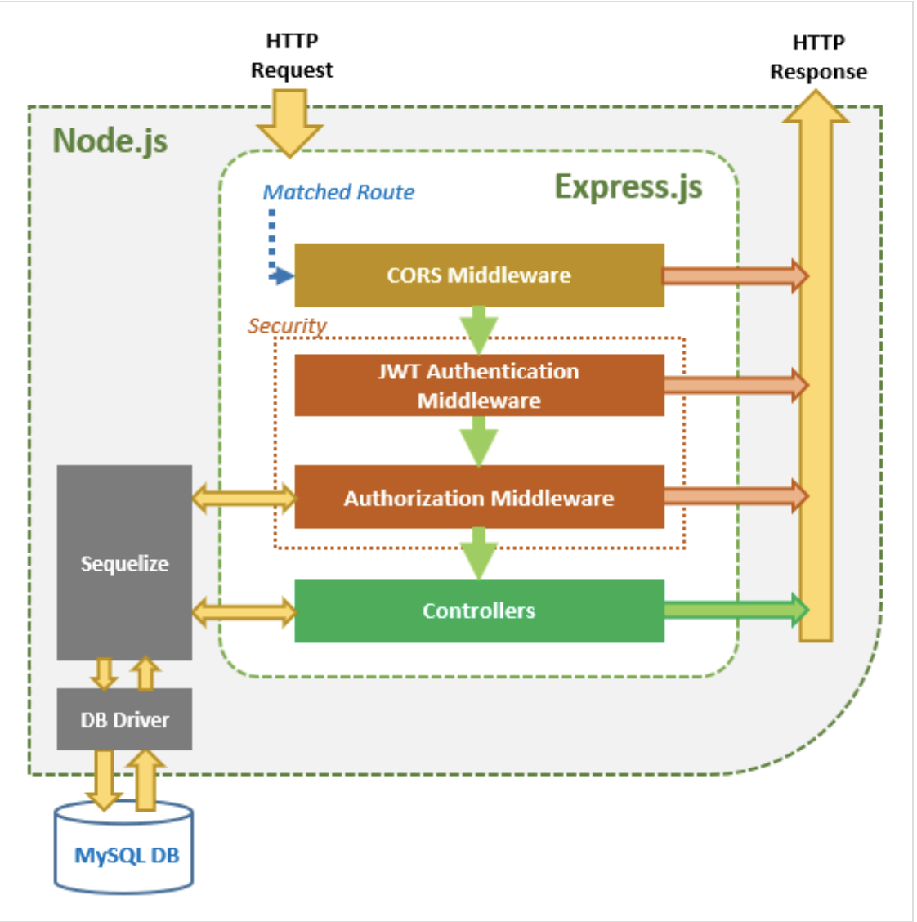
Graduation IN Informatics engineering
3.1 Application Architecture
Project III
@2020/2021 – Luis Alonso 17506– Backend Node.js, Express, MySQL
- 12 -

Slide 13
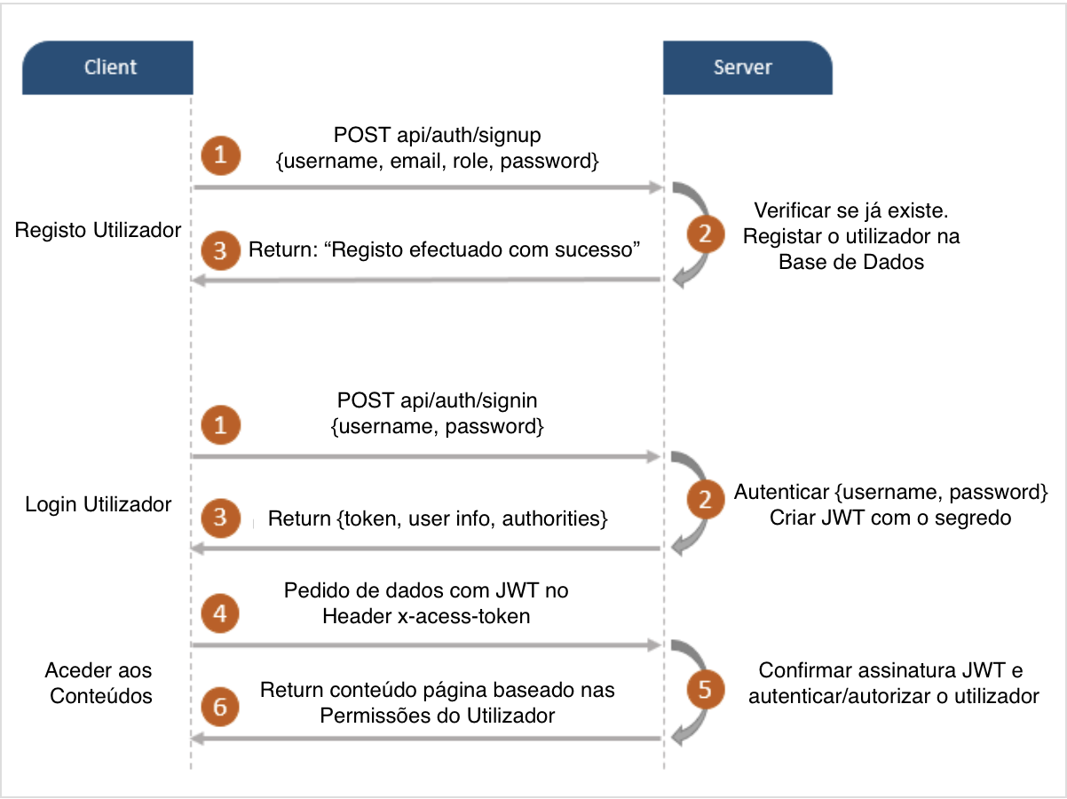
Graduation IN Informatics engineering
3.2 Flow for Signup & Login with JWT Authentication
Project III
@2020/2021 – Luis Alonso 17506– Backend Node.js, Express, MySQL
- 13 -

Slide 14
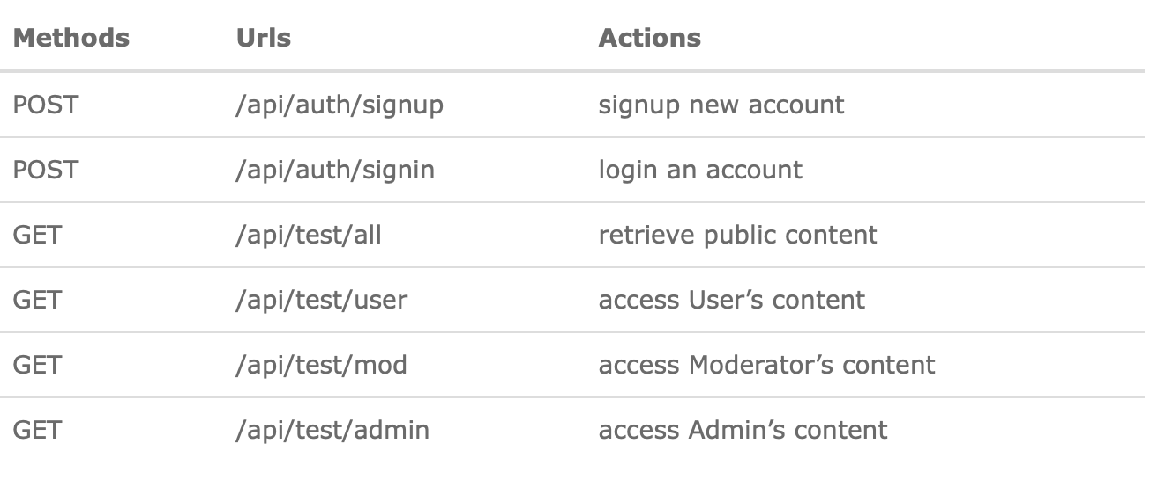
Graduation IN Informatics engineering
3.3 API EndPoints v1
Project III
@2020/2021 – Luis Alonso 17506– Backend Node.js, Express, MySQL
- 14 -

Slide 15
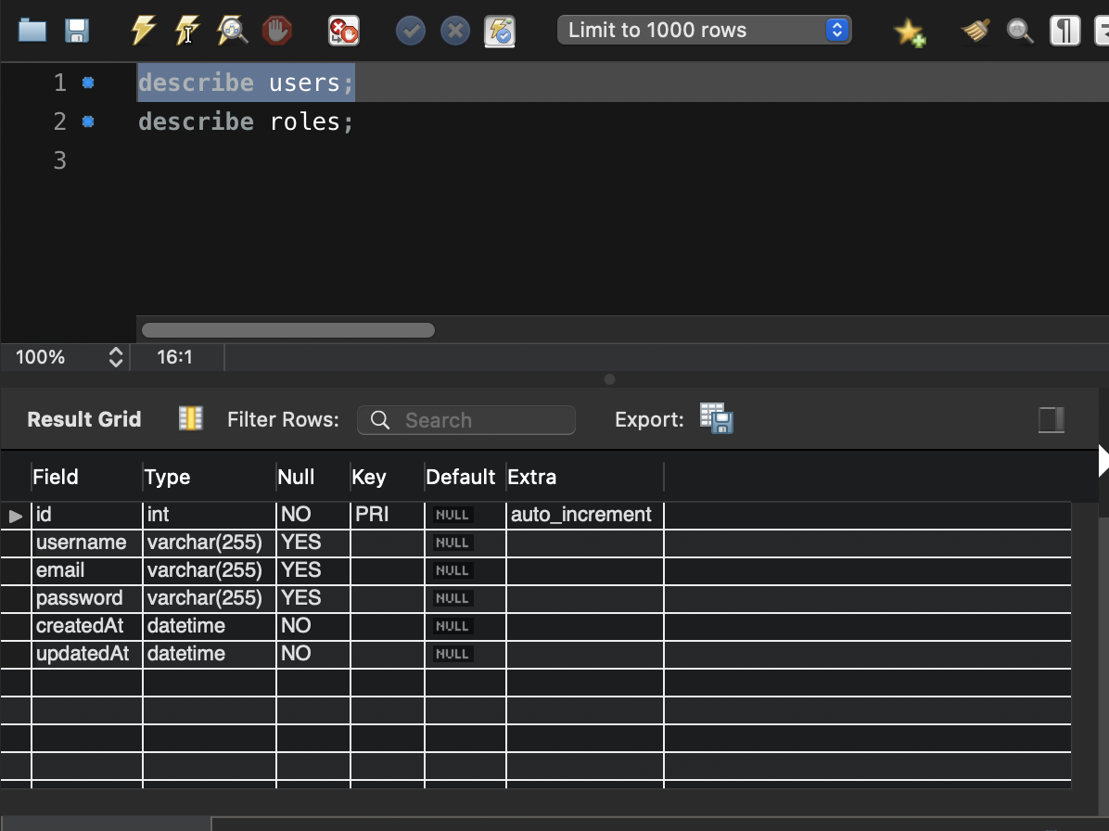
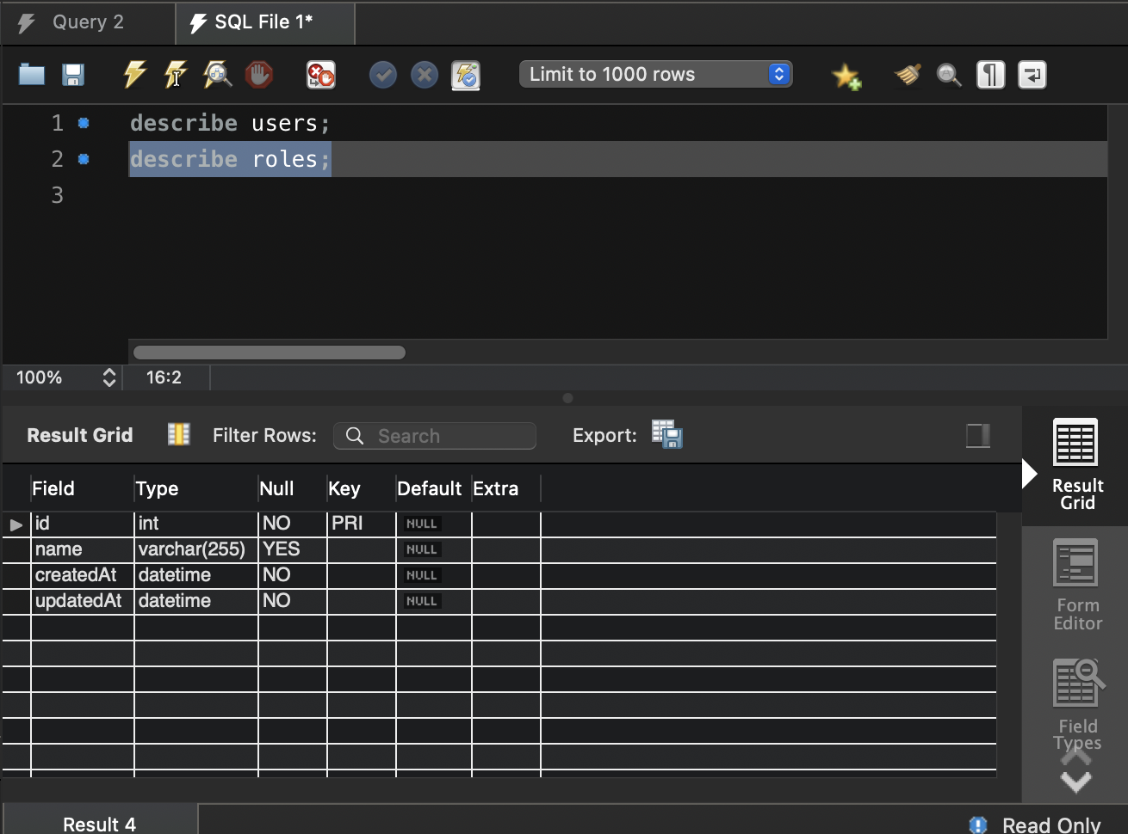
Graduation IN Informatics engineering
3.4 Tables created in the DataBase v1
Project III
@2020/2021 – Luis Alonso 17506– Backend Node.js, Express, MySQL
- 15 -

Slide 16
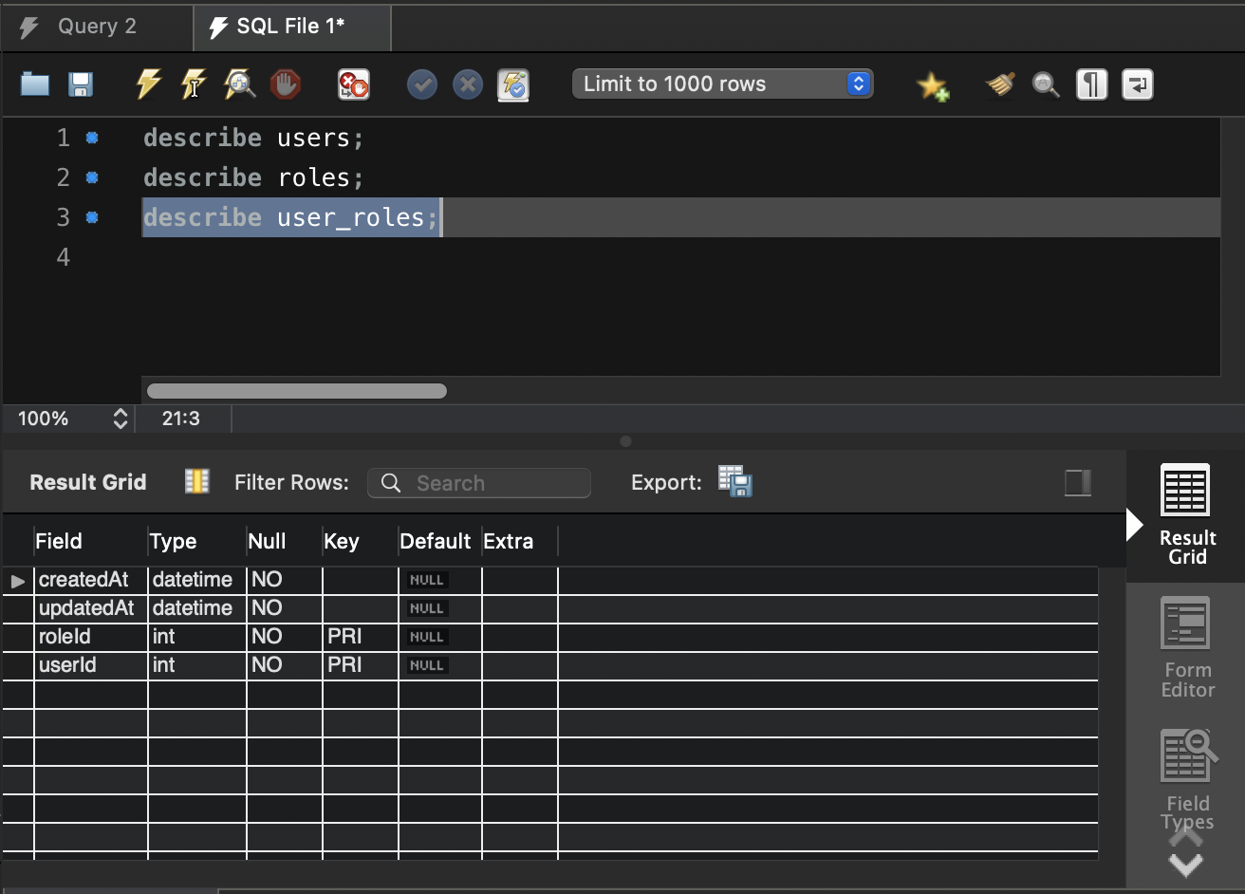
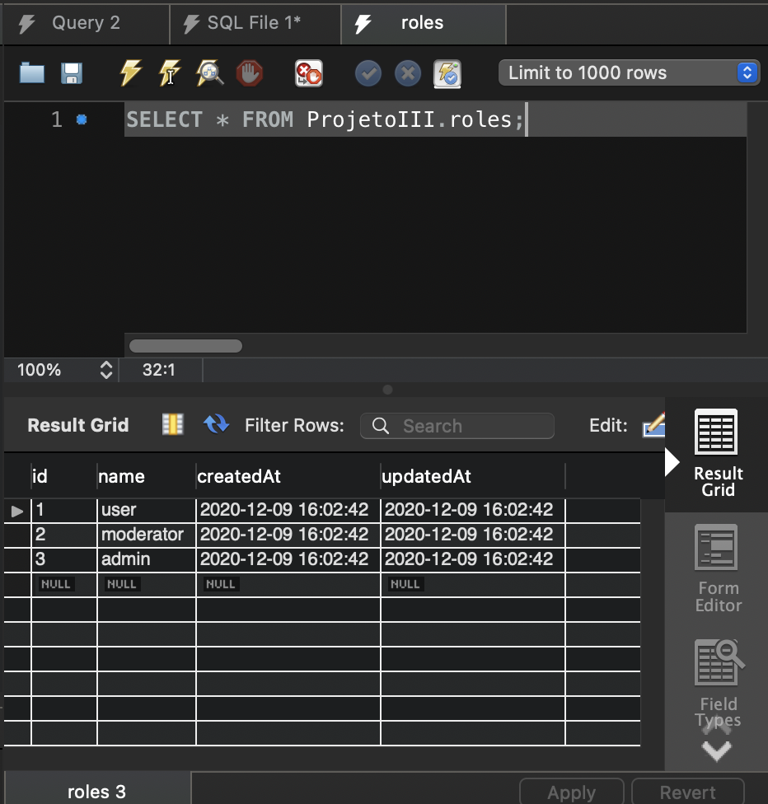
Graduation IN Informatics engineering
3.4 Tables created in the DataBase v1
Project III
@2020/2021 – Luis Alonso 17506– Backend Node.js, Express, MySQL
- 16 -

Slide 17
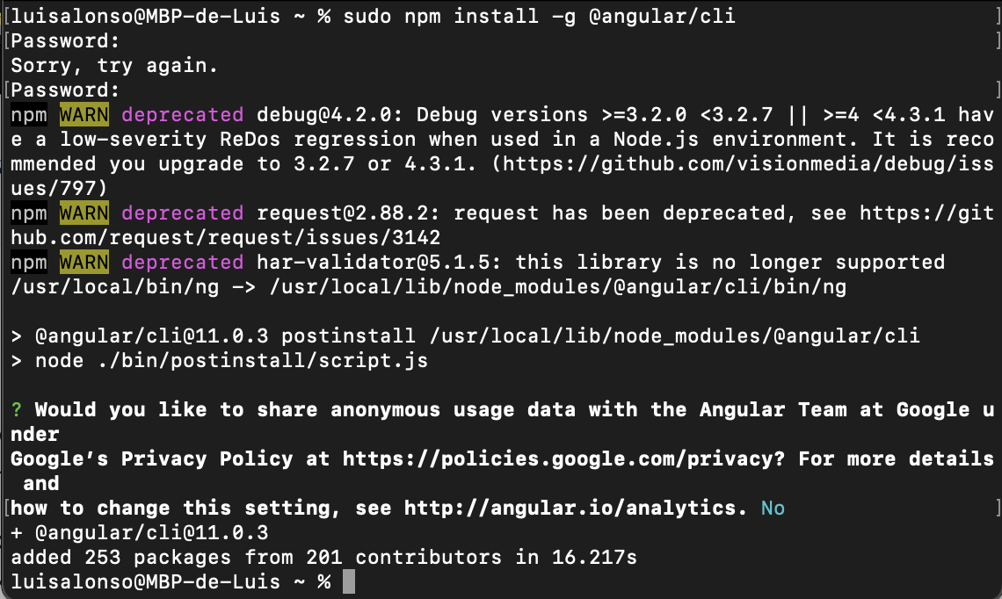
Graduation IN Informatics engineering
4. Implementation v1
Project III
Angular / Node Installation
@2020/2021 – Luis Alonso 17506– Backend Node.js, Express, MySQL
- 17 -

Slide 18
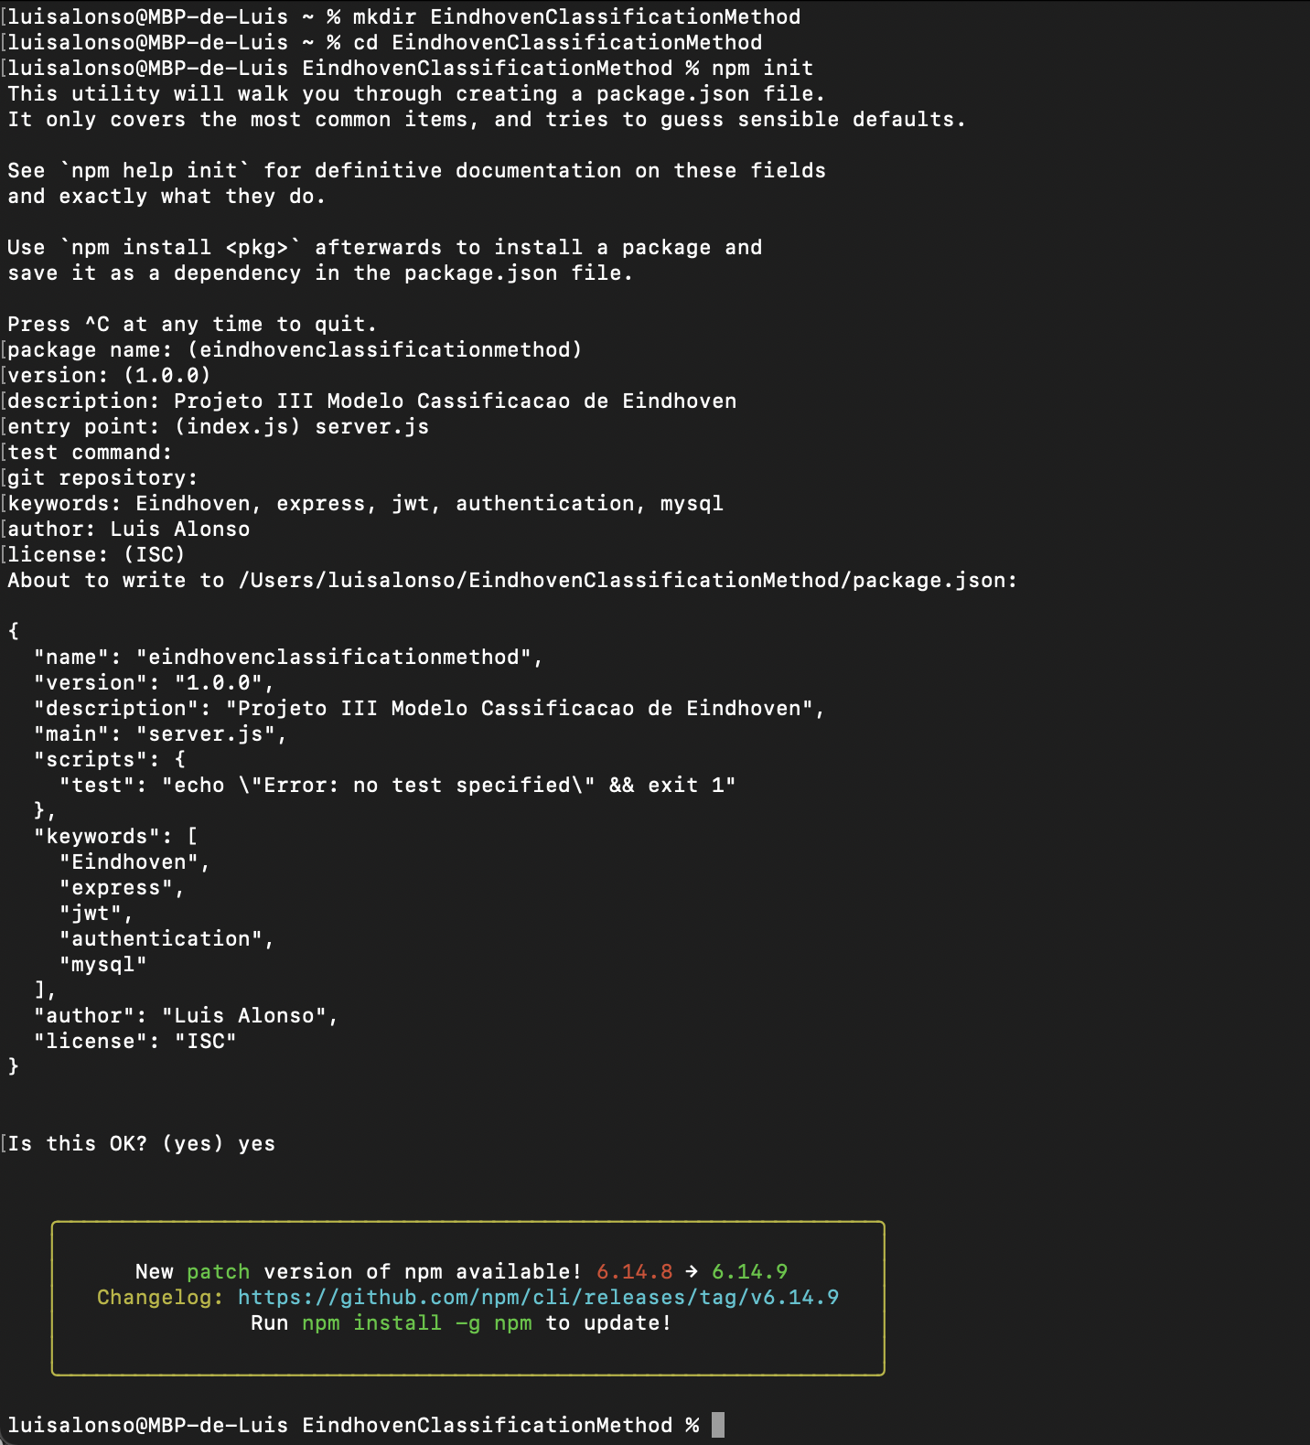
Graduation IN Informatics engineering
4. Implementation v1
Project III
Creating the Project called “Eindhoven Classification Method”
@2020/2021 – Luis Alonso 17506– Backend Node.js, Express, MySQL
- 18 -

Slide 19
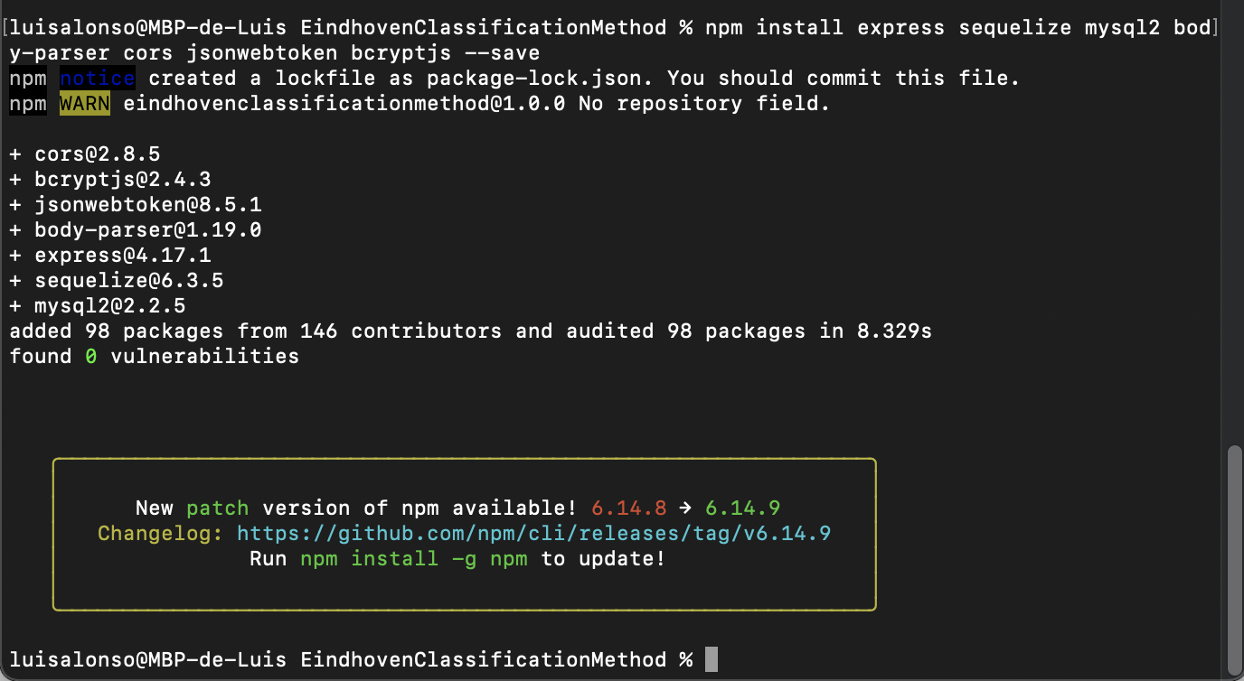
Graduation IN Informatics engineering
4. Implementation v1
Project III
Installation of the necessary modules
@2020/2021 – Luis Alonso 17506– Backend Node.js, Express, MySQL
- 19 -

Slide 20
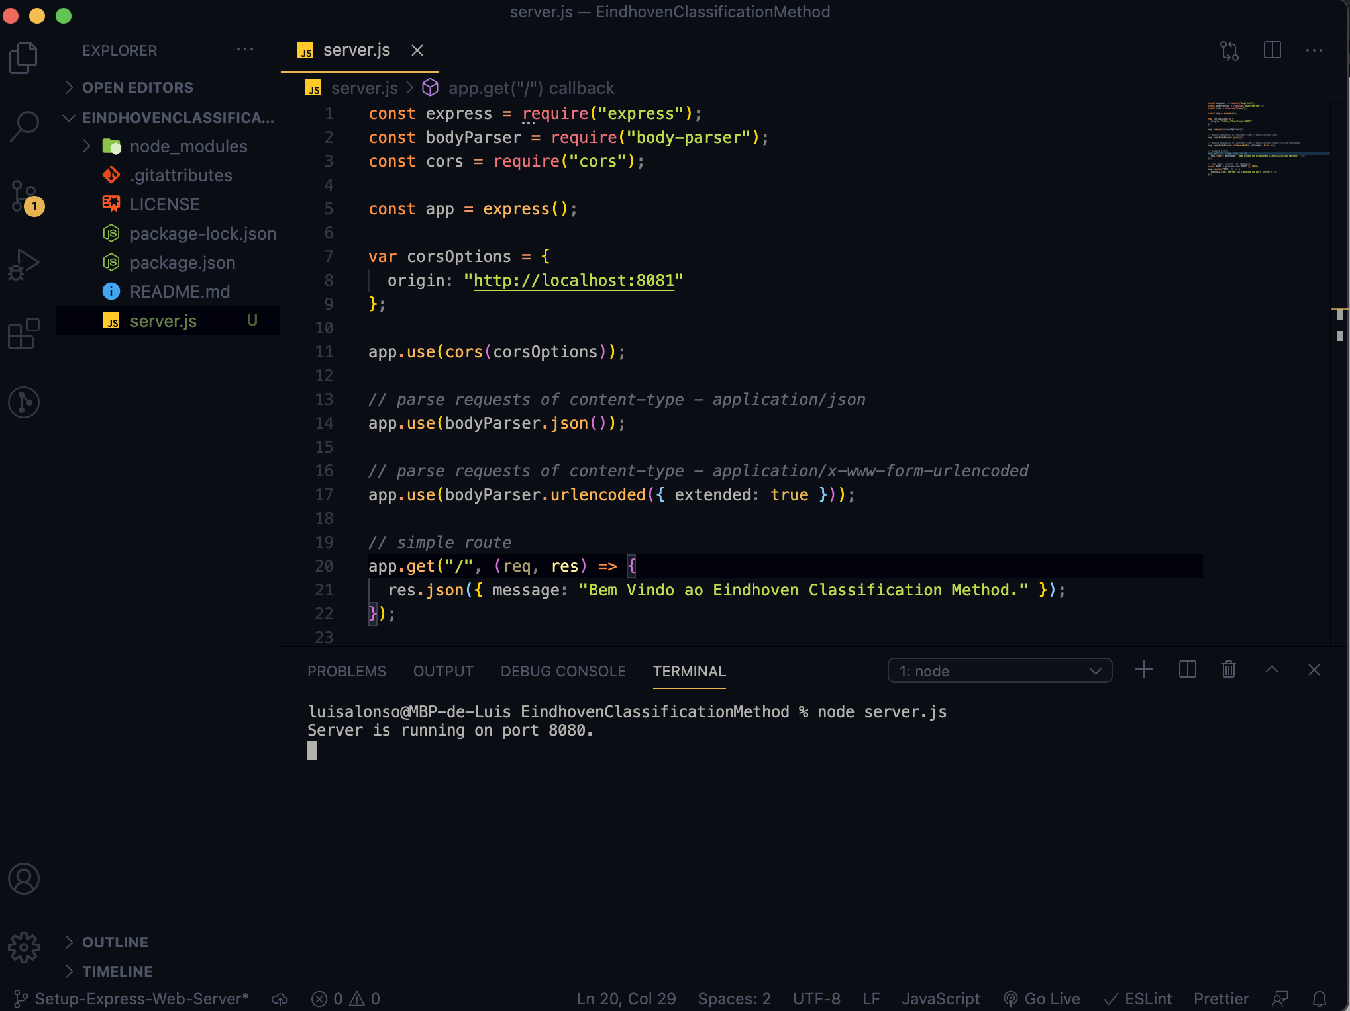
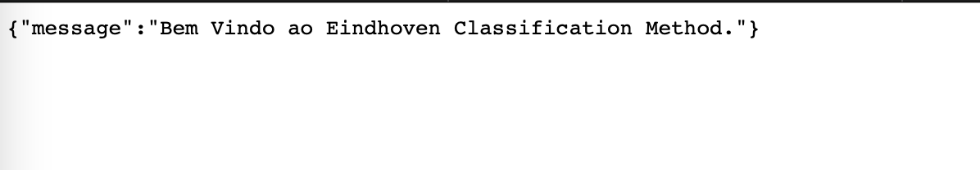
Graduation IN Informatics engineering
4. Implementation v1
Project III
Setup of Express.
@2020/2021 – Luis Alonso 17506– Backend Node.js, Express, MySQL
- 20 -

Slide 21
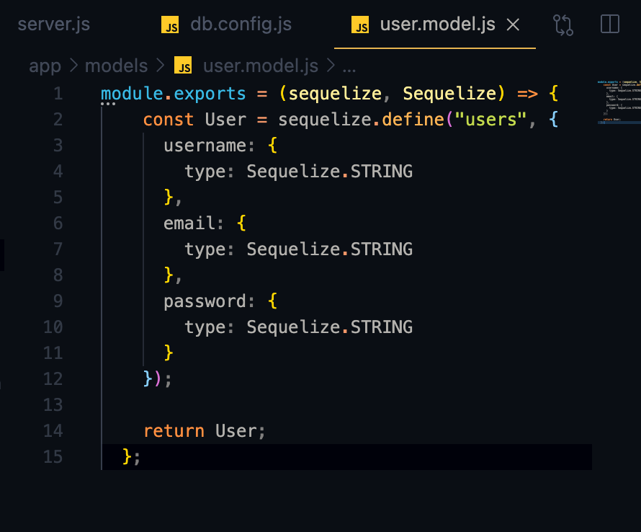
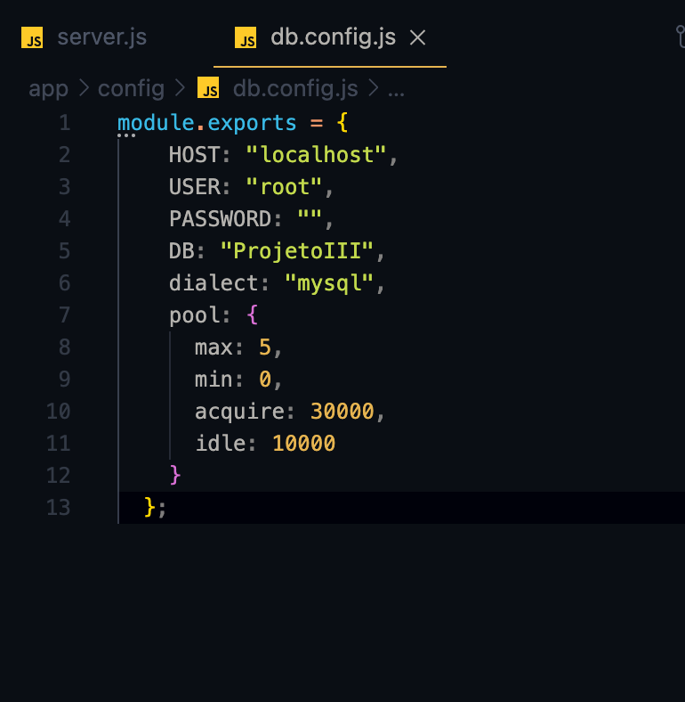
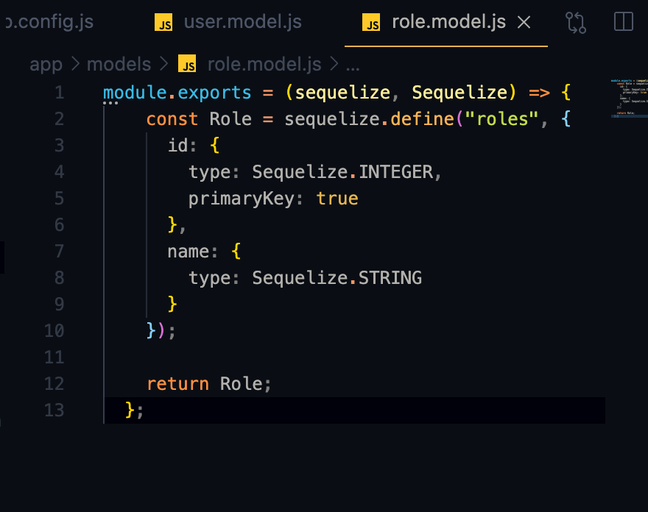
Graduation IN Informatics engineering
4. Implementation v1
Project III
Configuring MySQL and Sequelize
@2020/2021 – Luis Alonso 17506– Backend Node.js, Express, MySQL
- 21 -

Slide 22
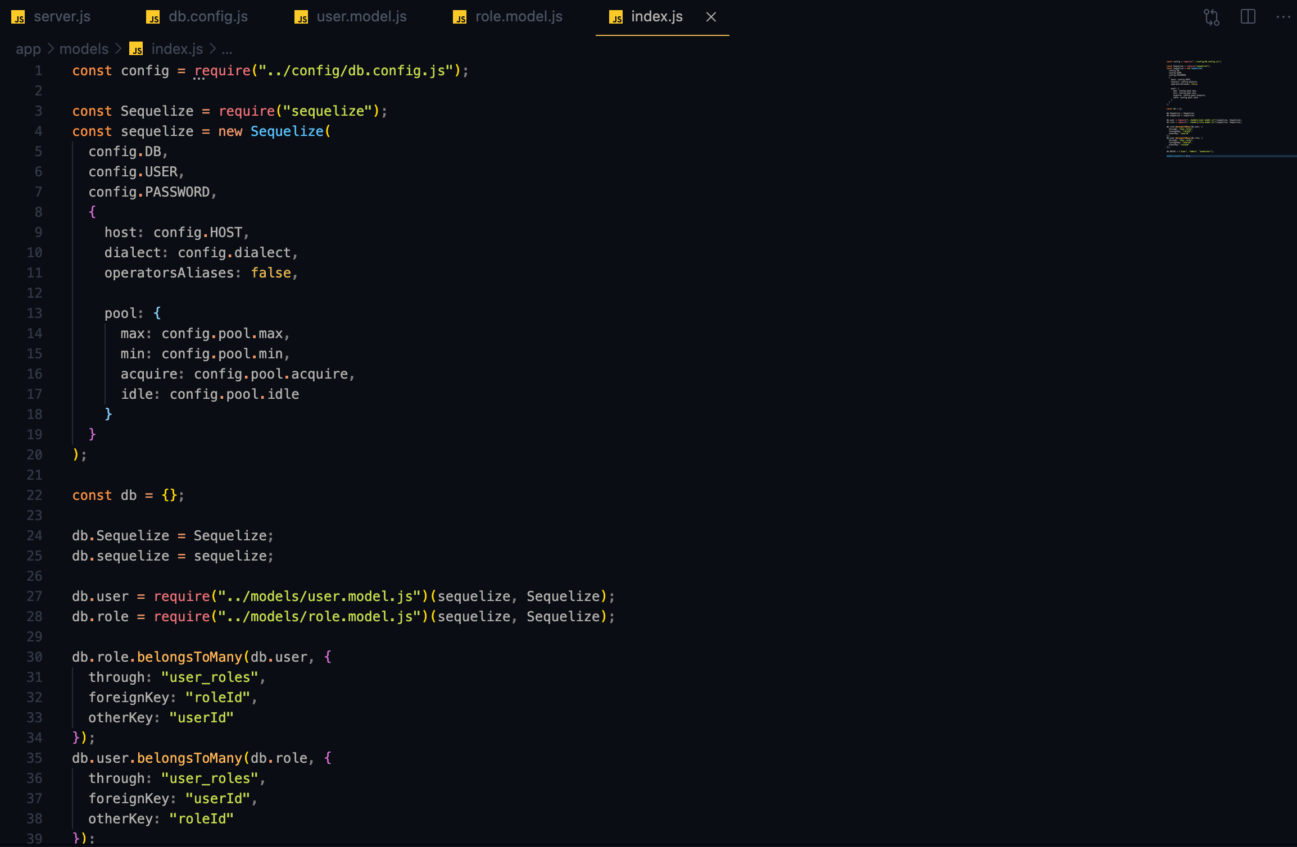
Graduation IN Informatics engineering
4. Implementation v1
Project III
Sync() Sequelize on Index.js
@2020/2021 – Luis Alonso 17506– Backend Node.js, Express, MySQL
- 22 -

Slide 23
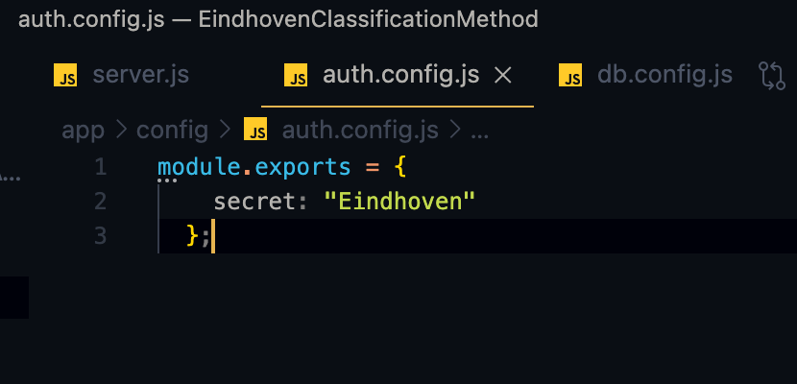
Graduation IN Informatics engineering
4. Implementation v1
Project III
Creating the secret for the functions: verify() / sign() of JsonWebToken.
The secret is, as previously stated, “Eindhoven”.
@2020/2021 – Luis Alonso 17506– Backend Node.js, Express, MySQL
- 23 -

Slide 24
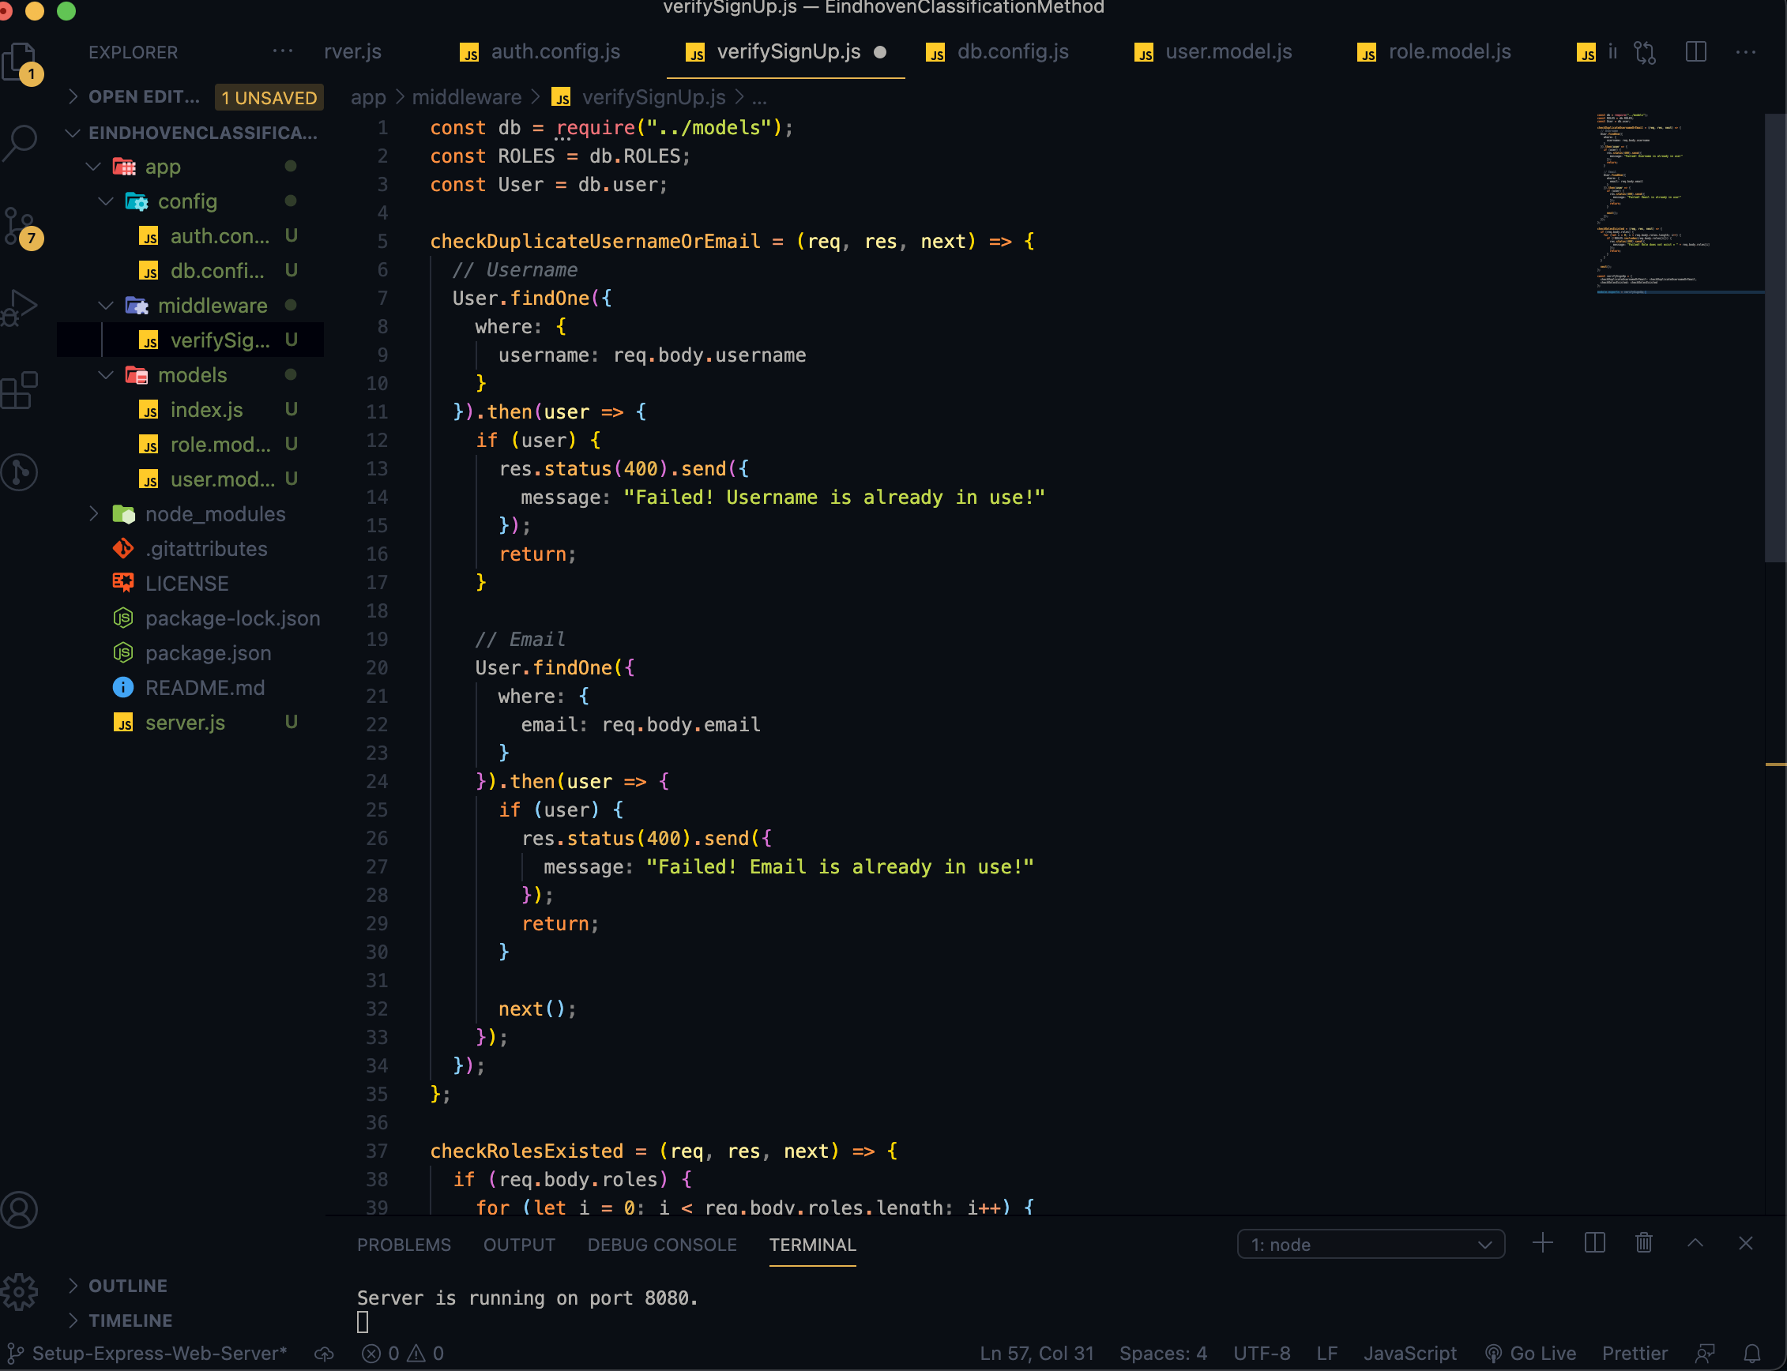
Graduation IN Informatics engineering
4. Implementation v1
Project III
Functions to verify SignUp (Checking there are no duplicates and checking if the Role exists.)
@2020/2021 – Luis Alonso 17506– Backend Node.js, Express, MySQL
- 24 -

Slide 25
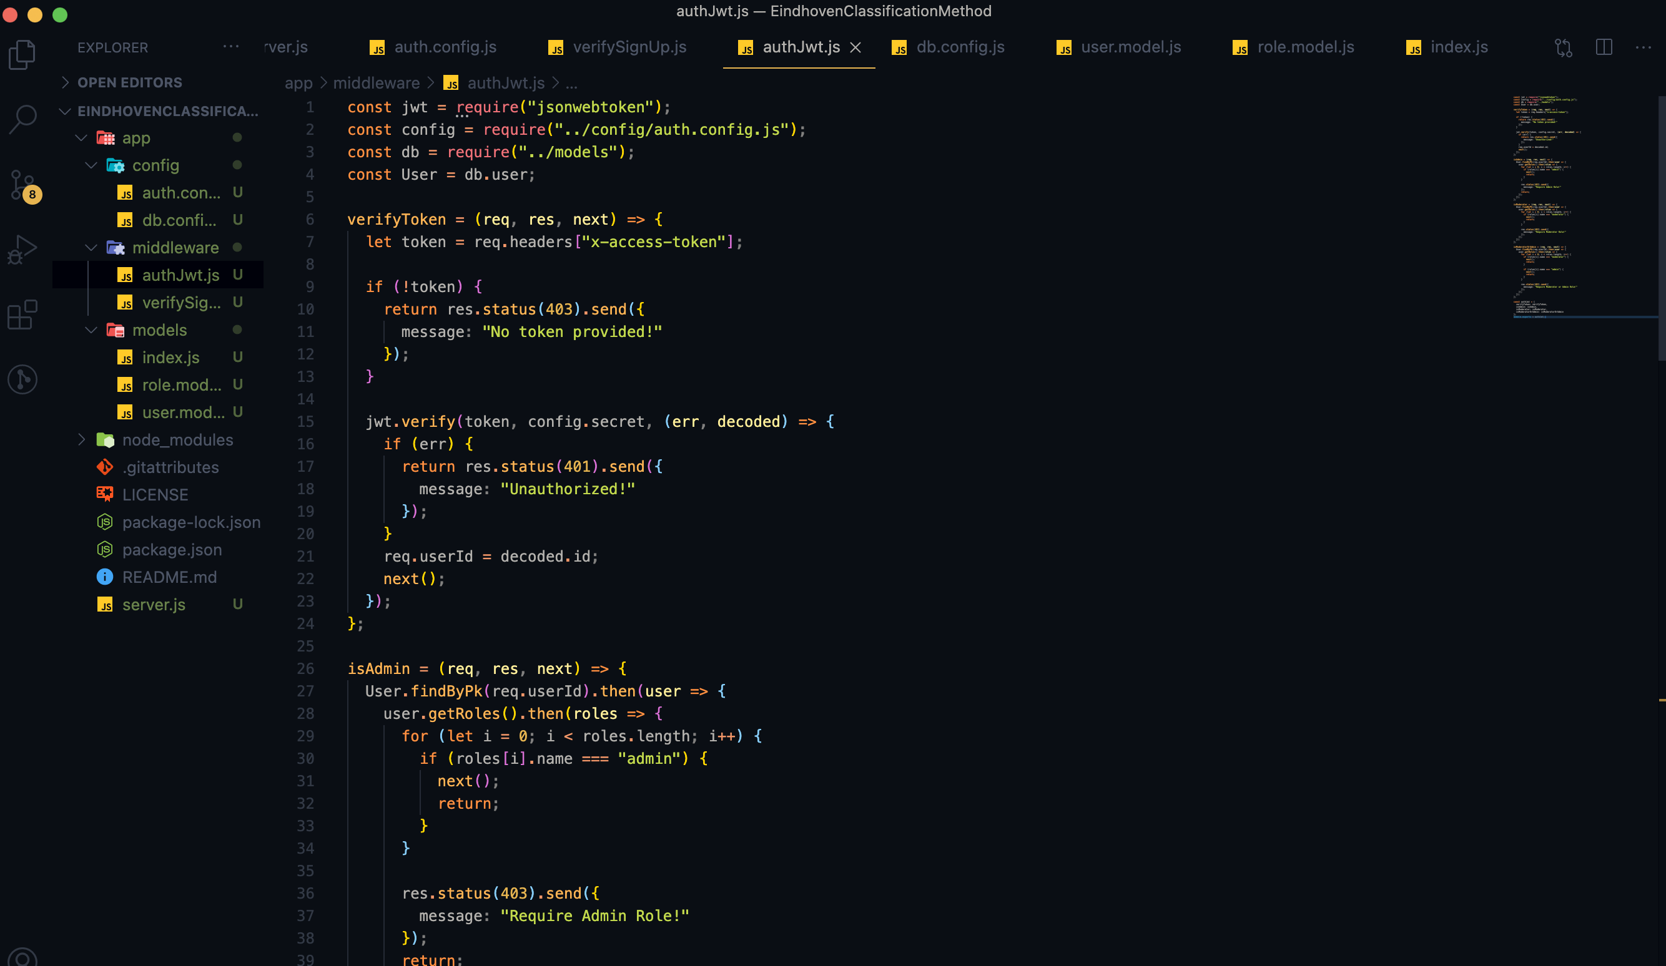
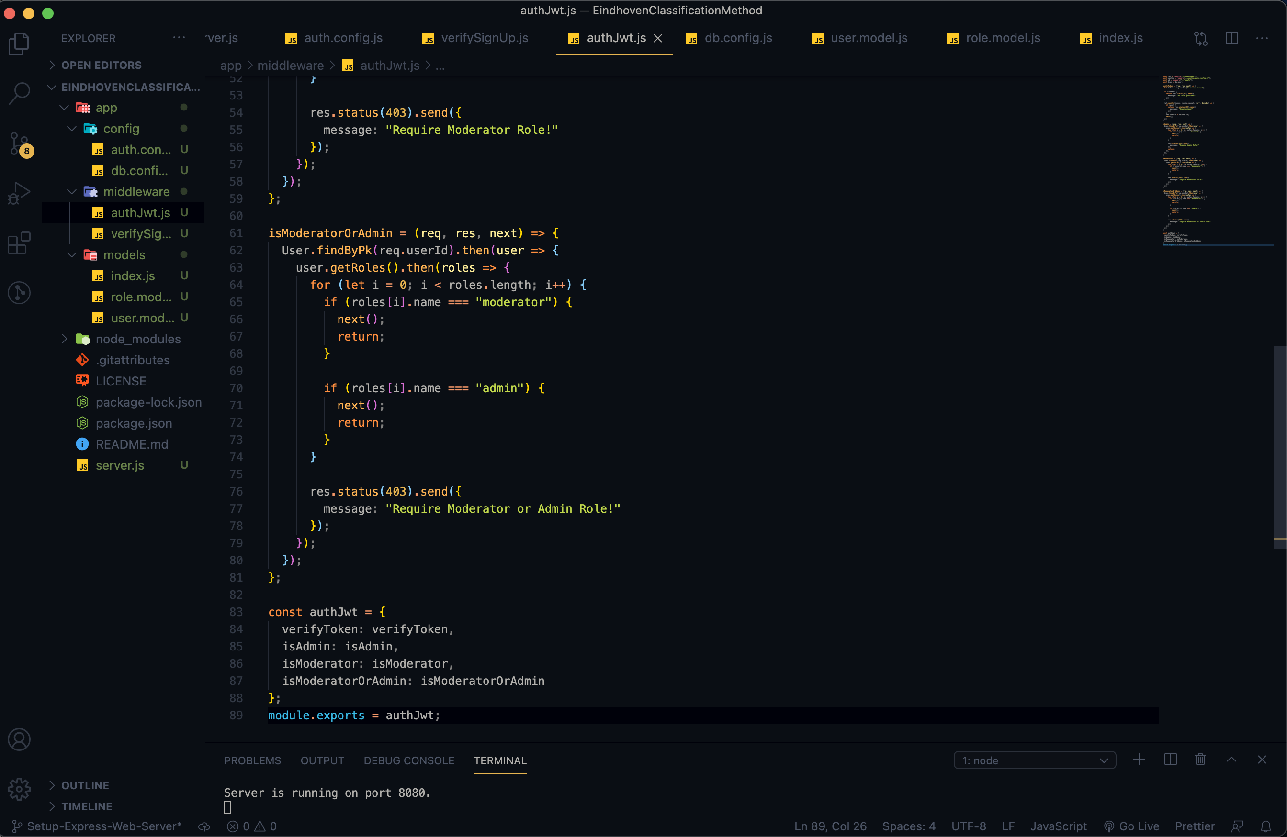
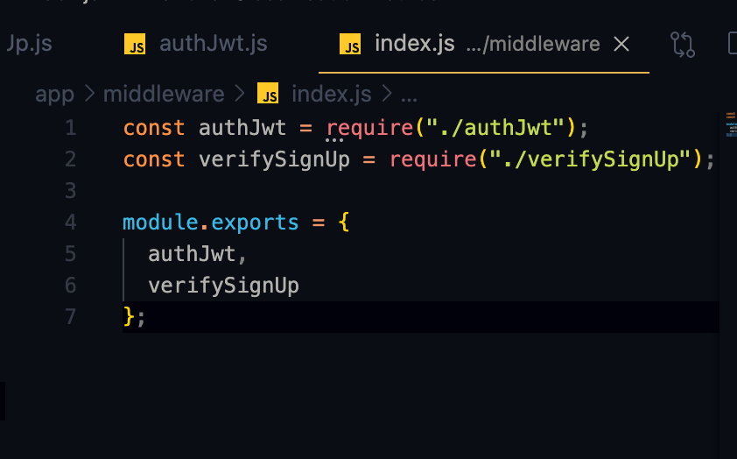
Graduation IN Informatics engineering
4. Implementation v1
Project III
Verify the Token (if it is provided/ legal or not), through the function verify().
@2020/2021 – Luis Alonso 17506– Backend Node.js, Express, MySQL
- 25 -

Slide 26
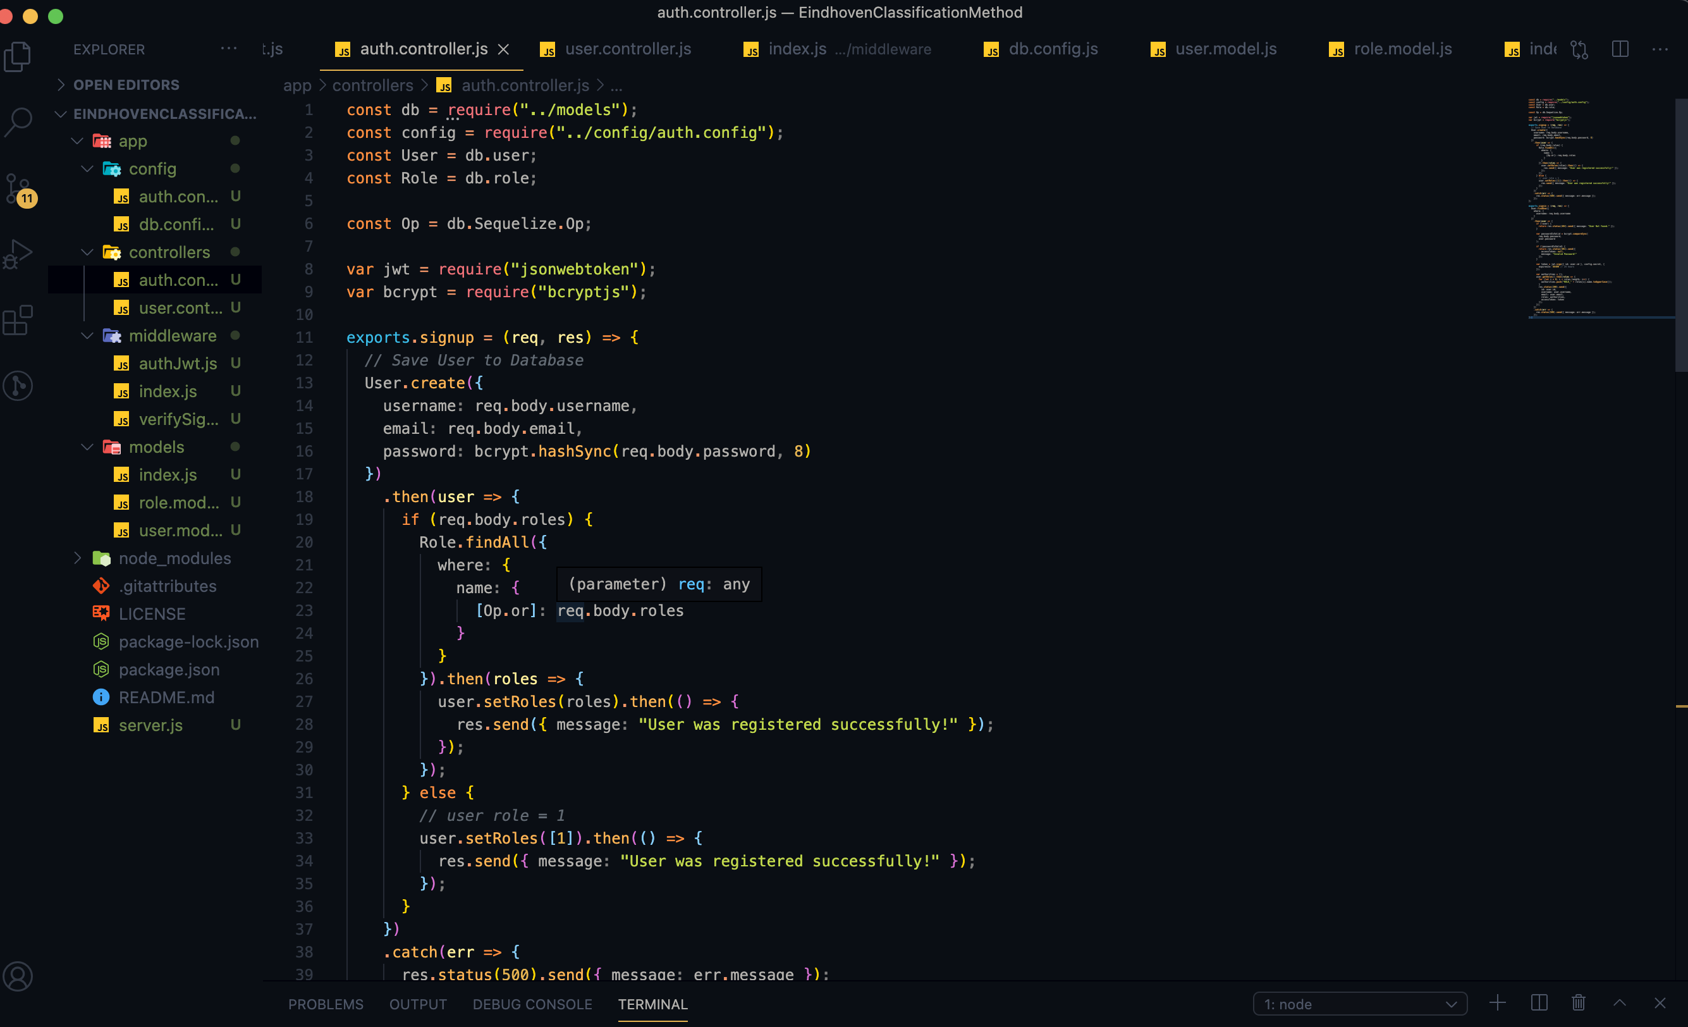
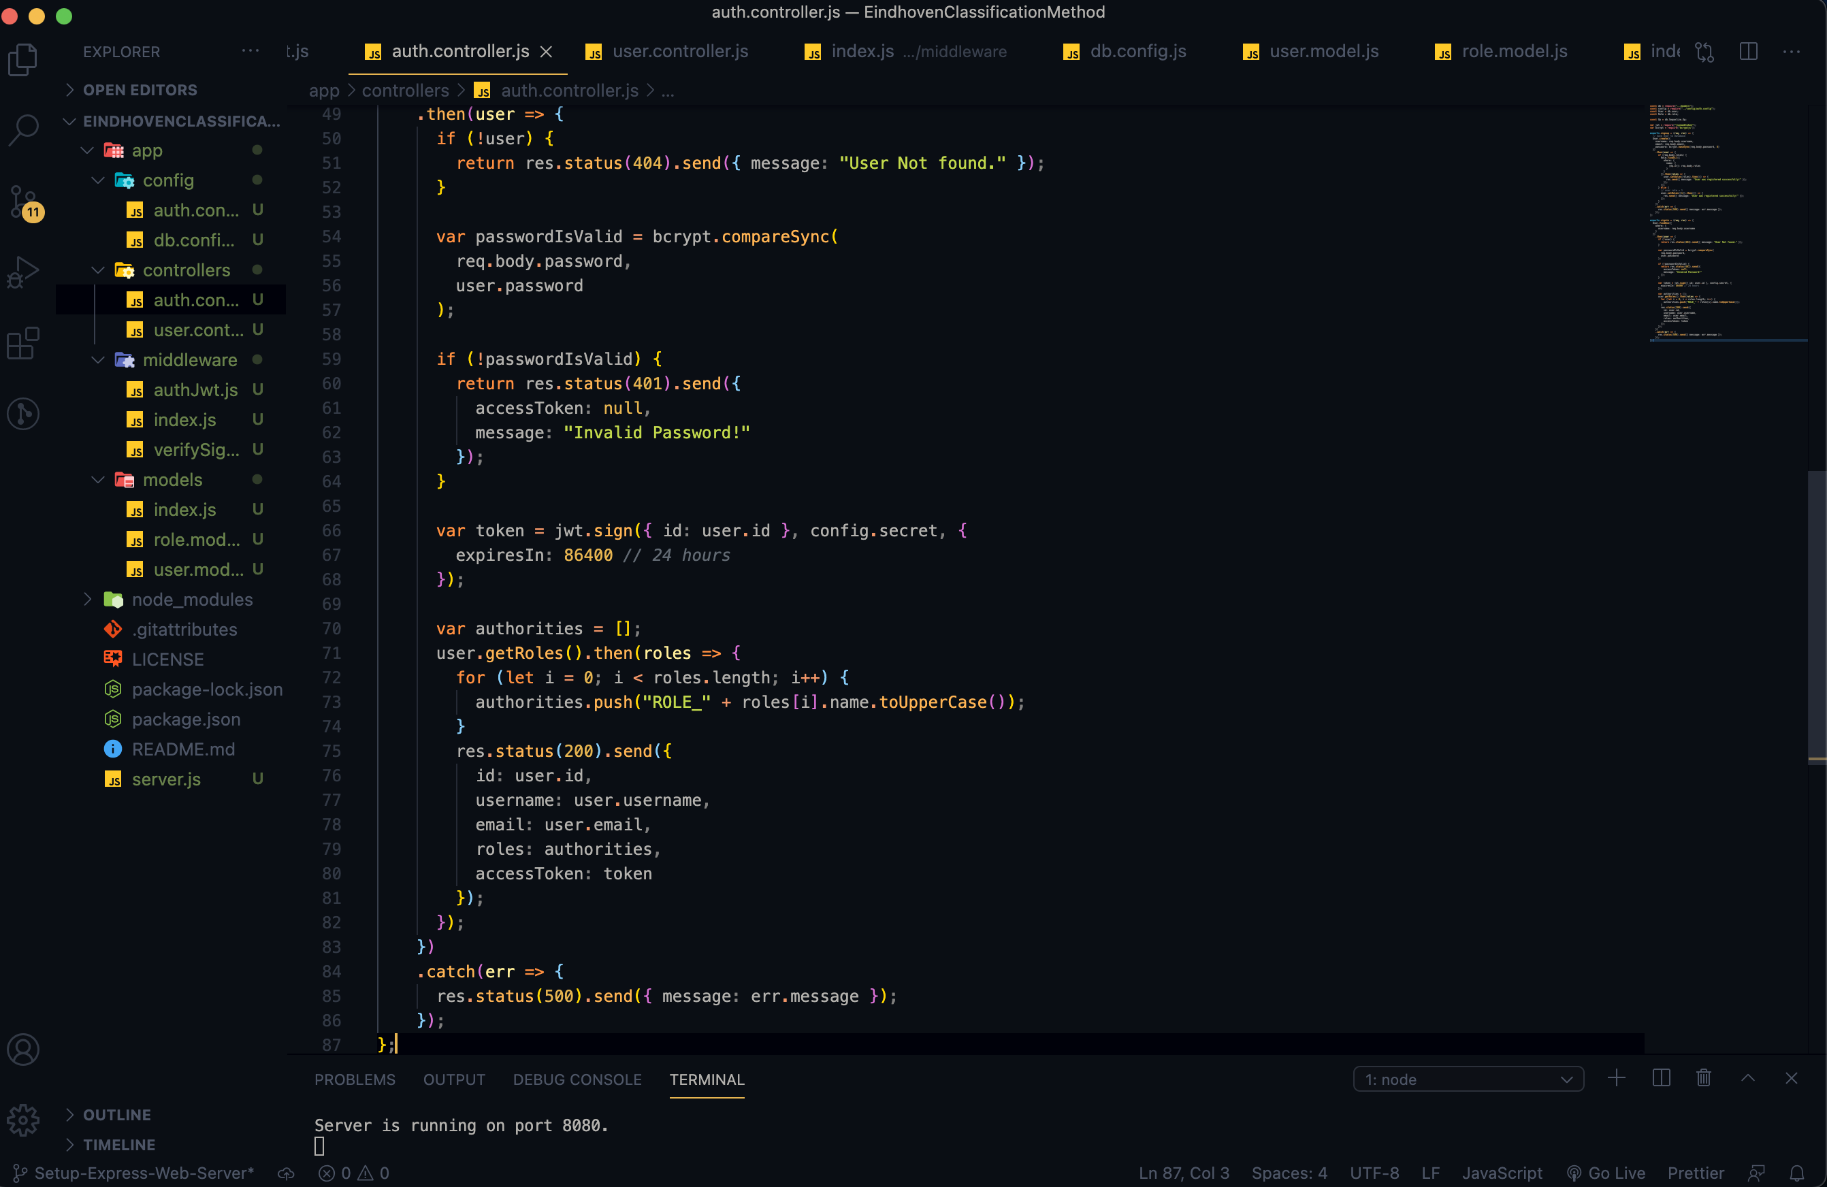
Graduation IN Informatics engineering
4. Implementation v1
Project III
Creating Authentication Controllers
@2020/2021 – Luis Alonso 17506– Backend Node.js, Express, MySQL
- 26 -

Slide 27
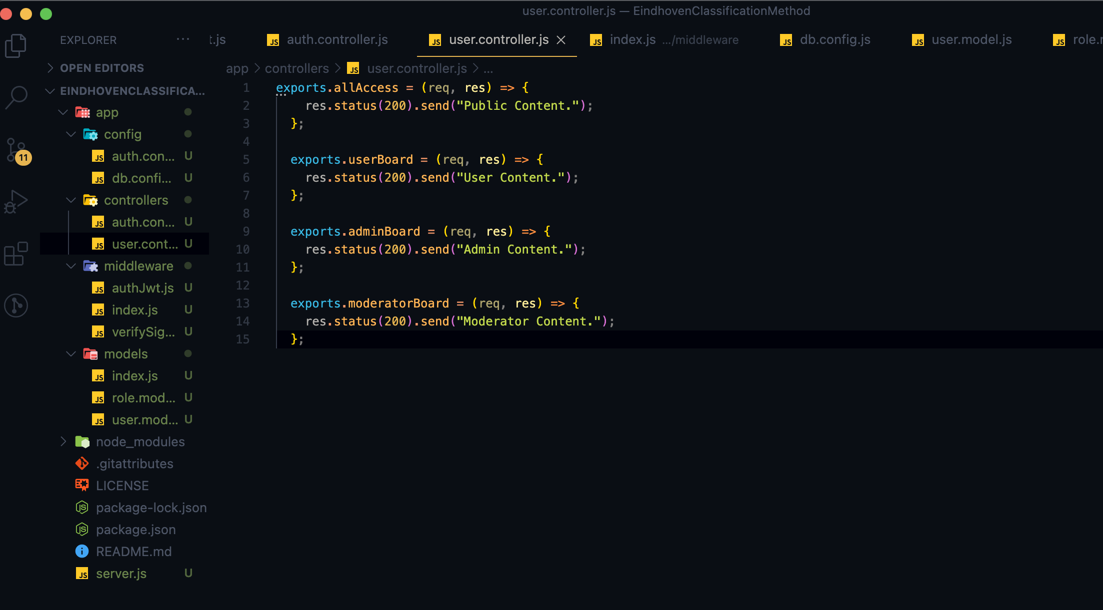
Graduation IN Informatics engineering
4. Implementation v1
Project III
Controller to test permissions.
/api/test/all
/api/test/user
/api/test/mod
/api/test/admin
@2020/2021 – Luis Alonso 17506– Backend Node.js, Express, MySQL
- 27 -

Slide 28
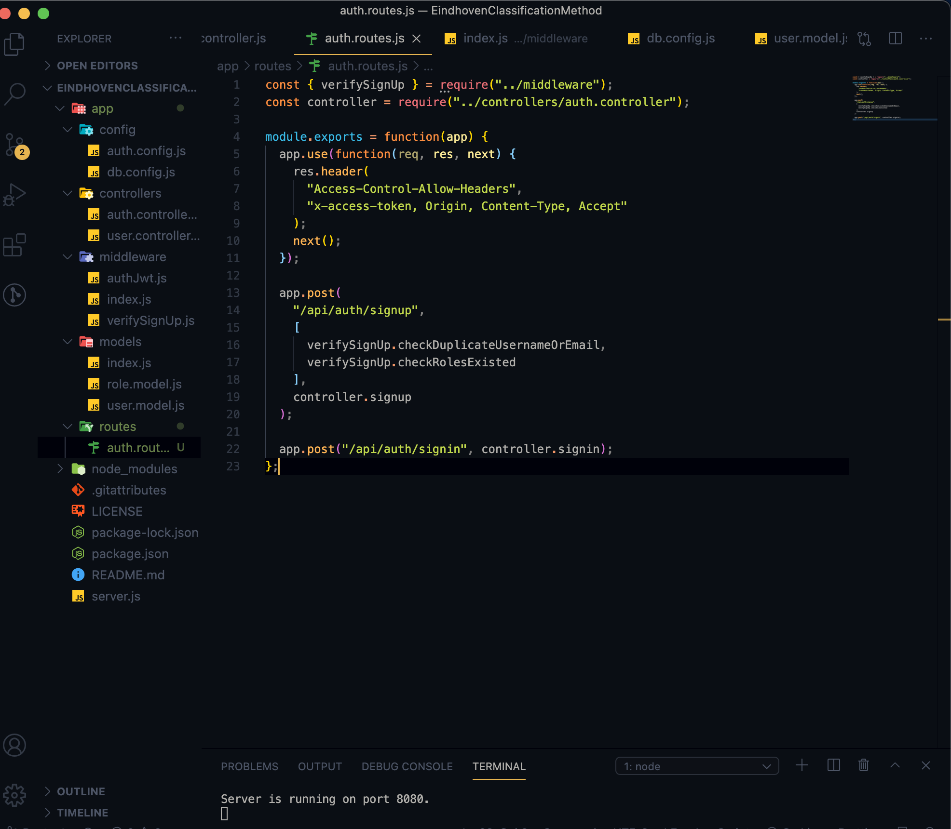
Graduation IN Informatics engineering
4. Implementation v1
Project III
When a client sends request for an endpoint using HTTP request (GET, POST, PUT, DELETE), we need to determine how the server will respond by setting up the routes.
We can separate our routes into 2 parts: Authentication and Authorization
Authentication
POST /api/auth/signup POST /apu/auth/signin
@2020/2021 – Luis Alonso 17506– Backend Node.js, Express, MySQL
- 28 -

Slide 29
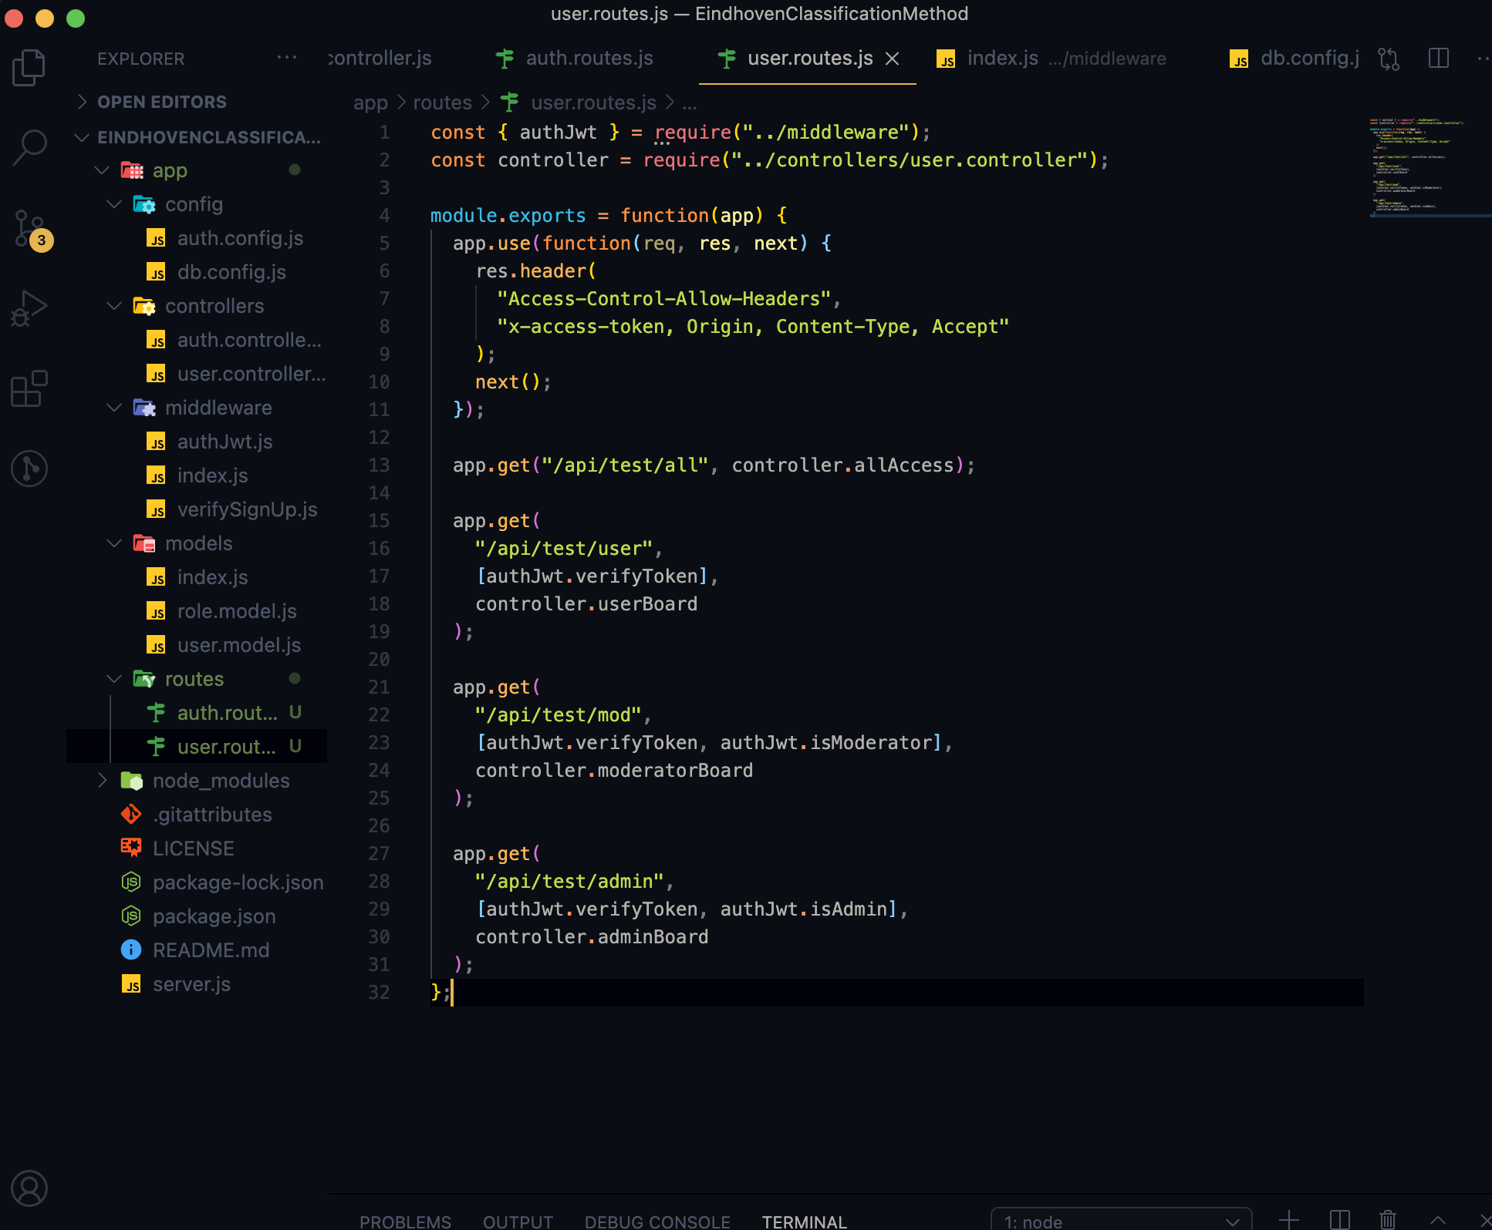
Graduation IN Informatics engineering
4. Implementation v1
Project III
Authorization
GET /api/test/all
GET /api/test/user
GET /api/test/mod
GET /api/test/admin
@2020/2021 – Luis Alonso 17506– Backend Node.js, Express, MySQL
- 29 -

Slide 30
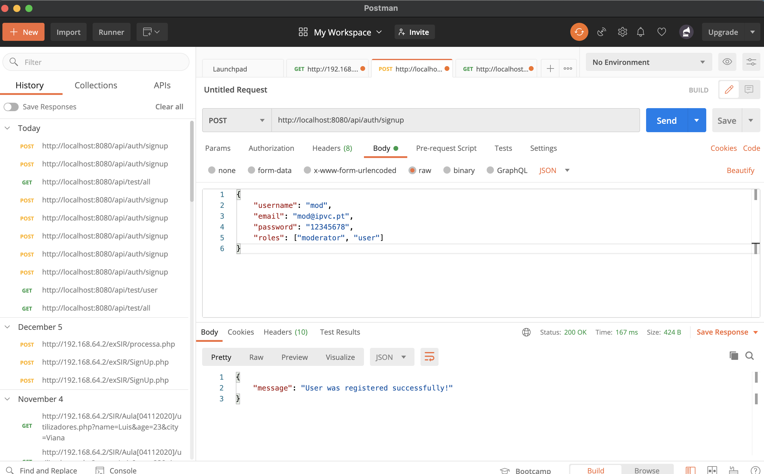
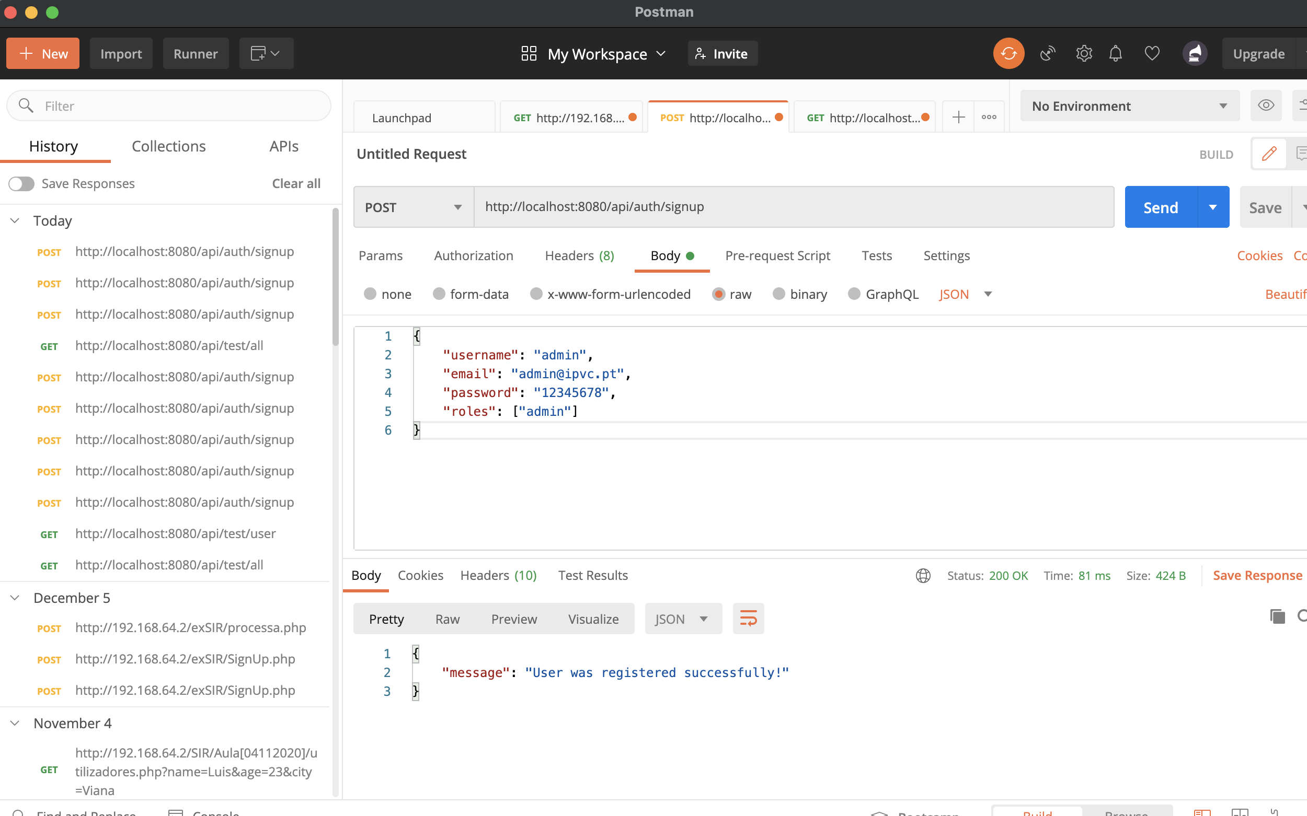
Graduation IN Informatics engineering
5. Postman Testing
Project III
@2020/2021 – Luis Alonso 17506– Backend Node.js, Express, MySQL
- 30 -

Slide 31
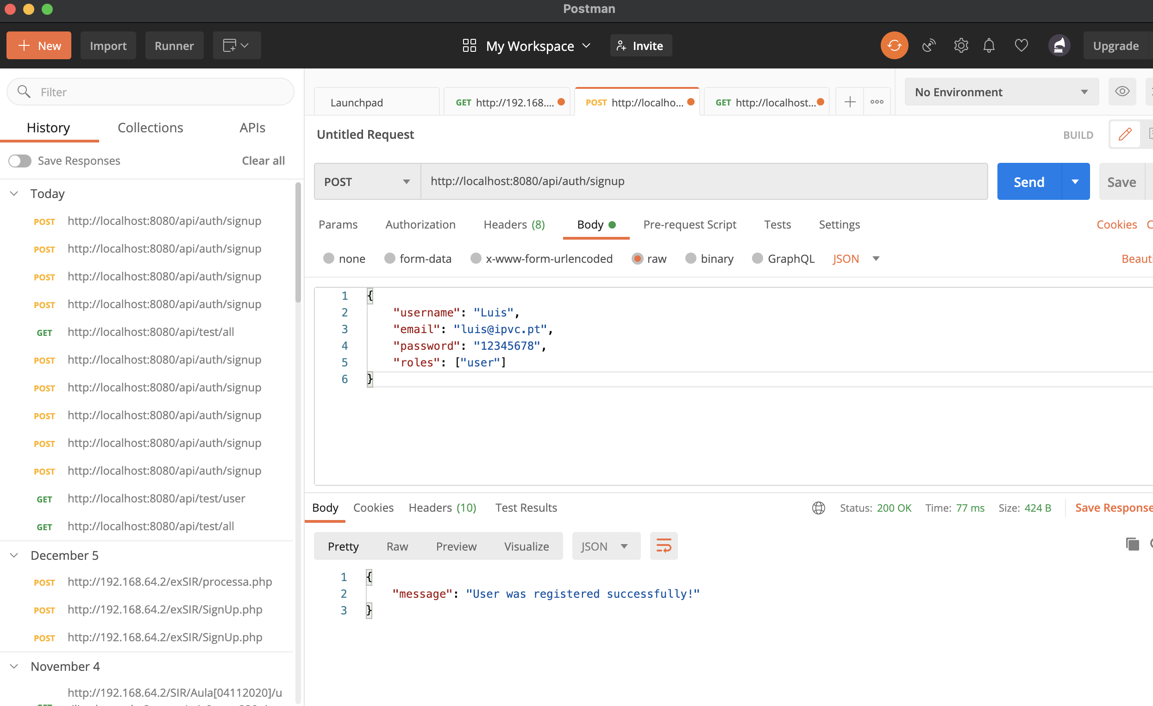
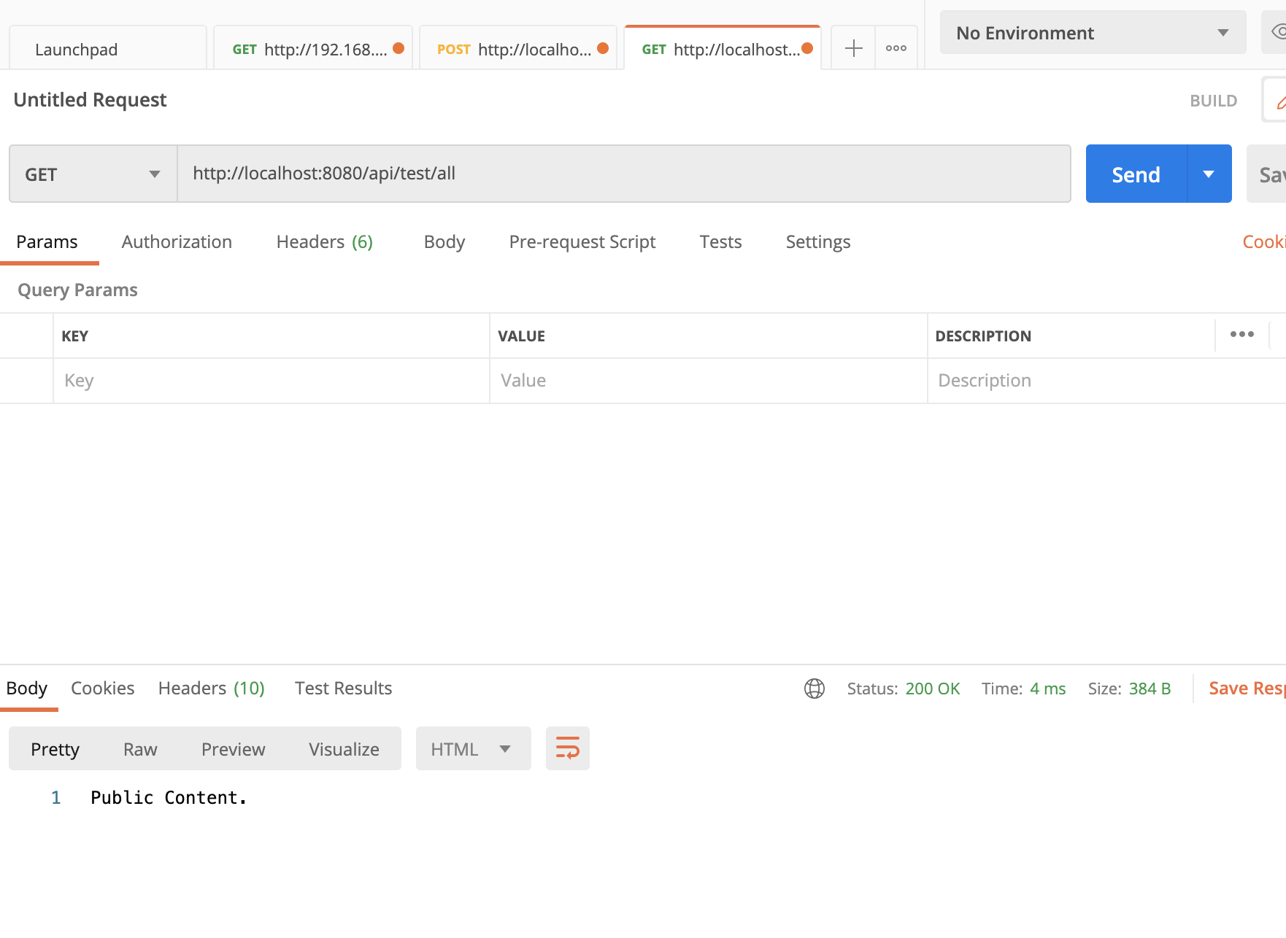
Graduation IN Informatics engineering
5. Postman Testing
Project III
@2020/2021 – Luis Alonso 17506– Backend Node.js, Express, MySQL
- 31 -

Slide 32
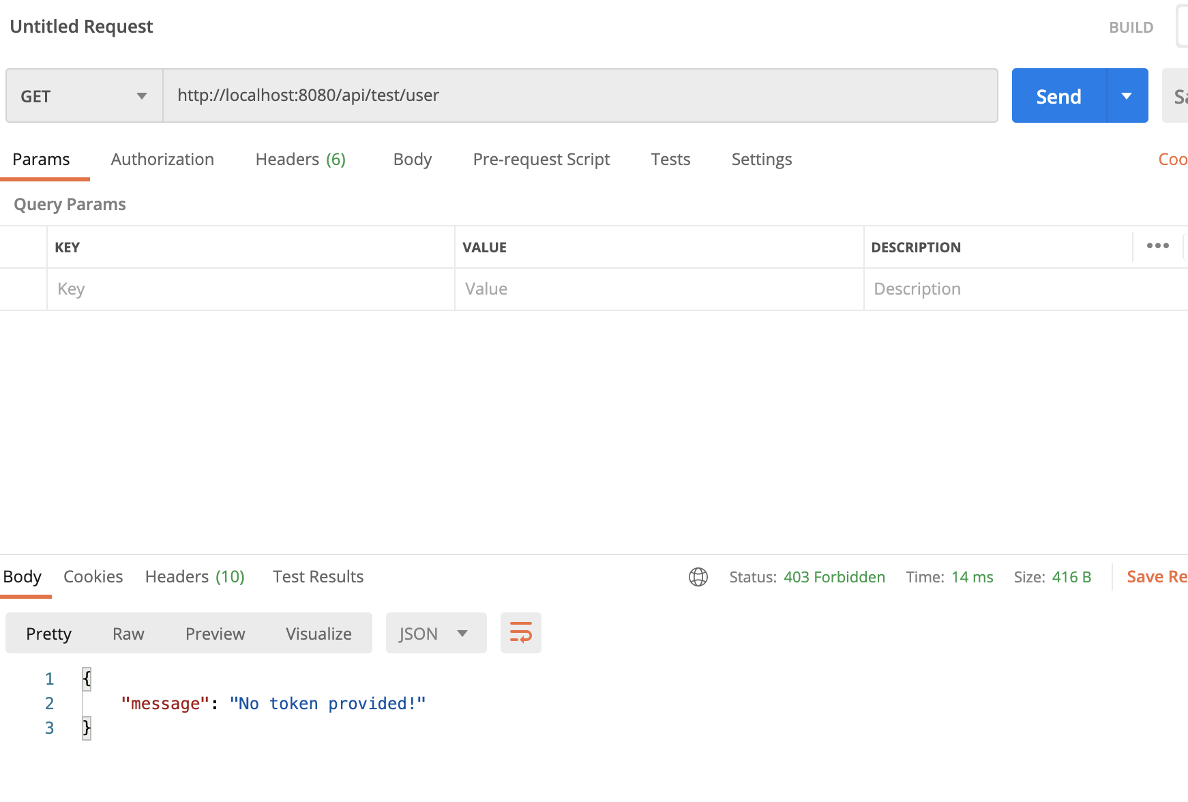
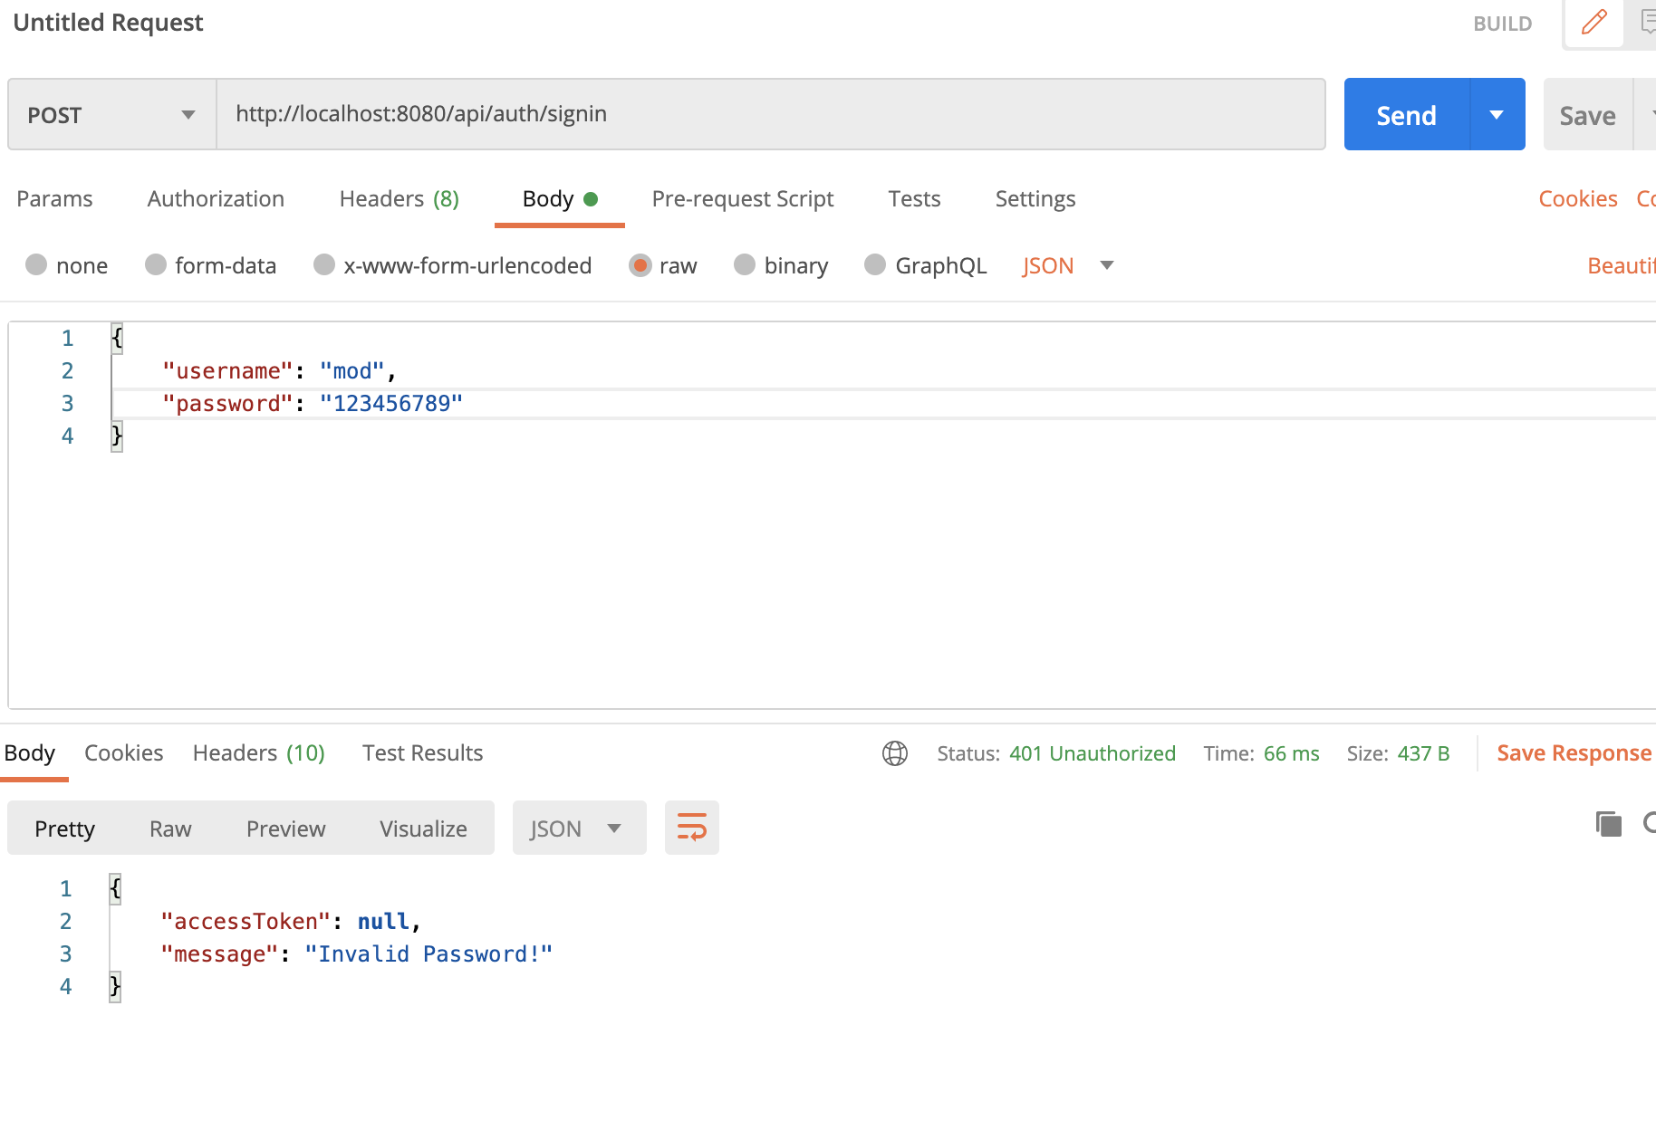
Graduation IN Informatics engineering
5. Postman Testing
Project III
@2020/2021 – Luis Alonso 17506– Backend Node.js, Express, MySQL
- 32 -

Slide 33
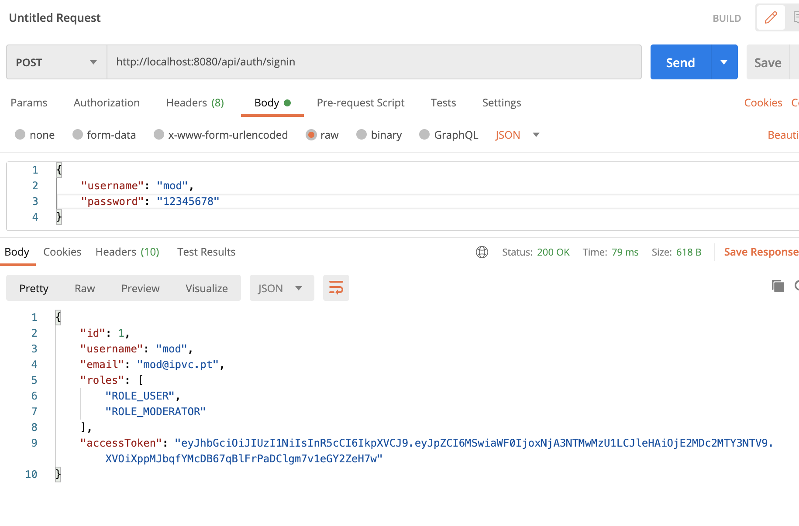
Graduation IN Informatics engineering
5. Postman Testing
Project III
@2020/2021 – Luis Alonso 17506– Backend Node.js, Express, MySQL
- 33 -

Slide 34
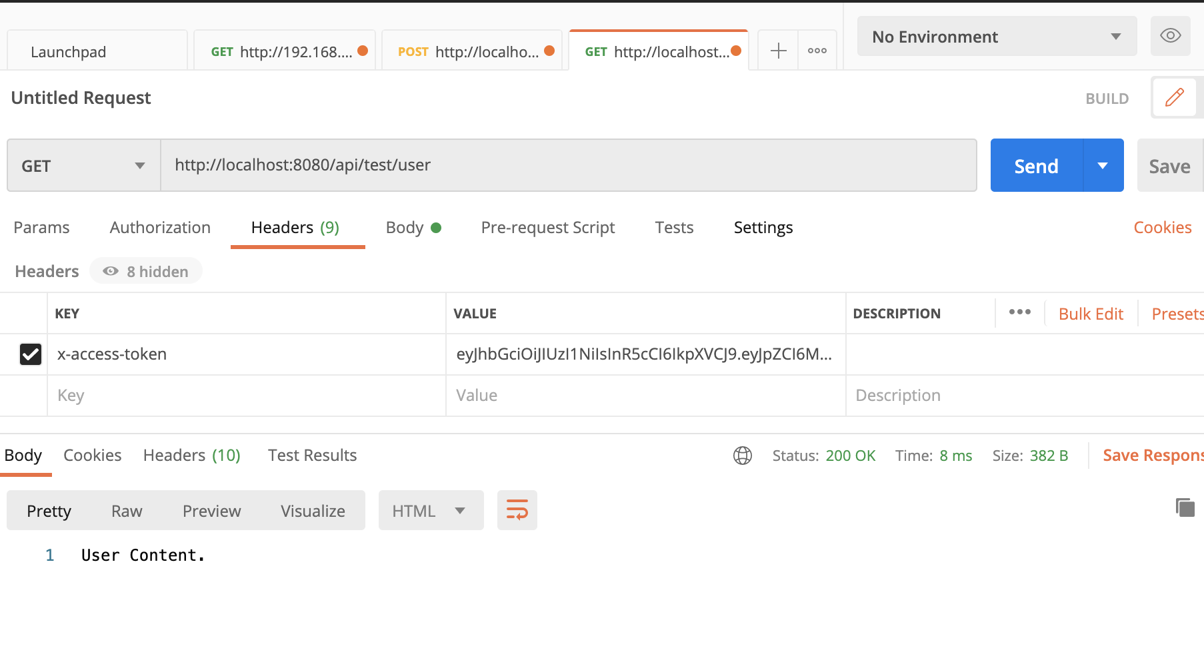
Graduation IN Informatics engineering
5. Postman Testing
Project III
@2020/2021 – Luis Alonso 17506– Backend Node.js, Express, MySQL
- 34 -

Slide 35
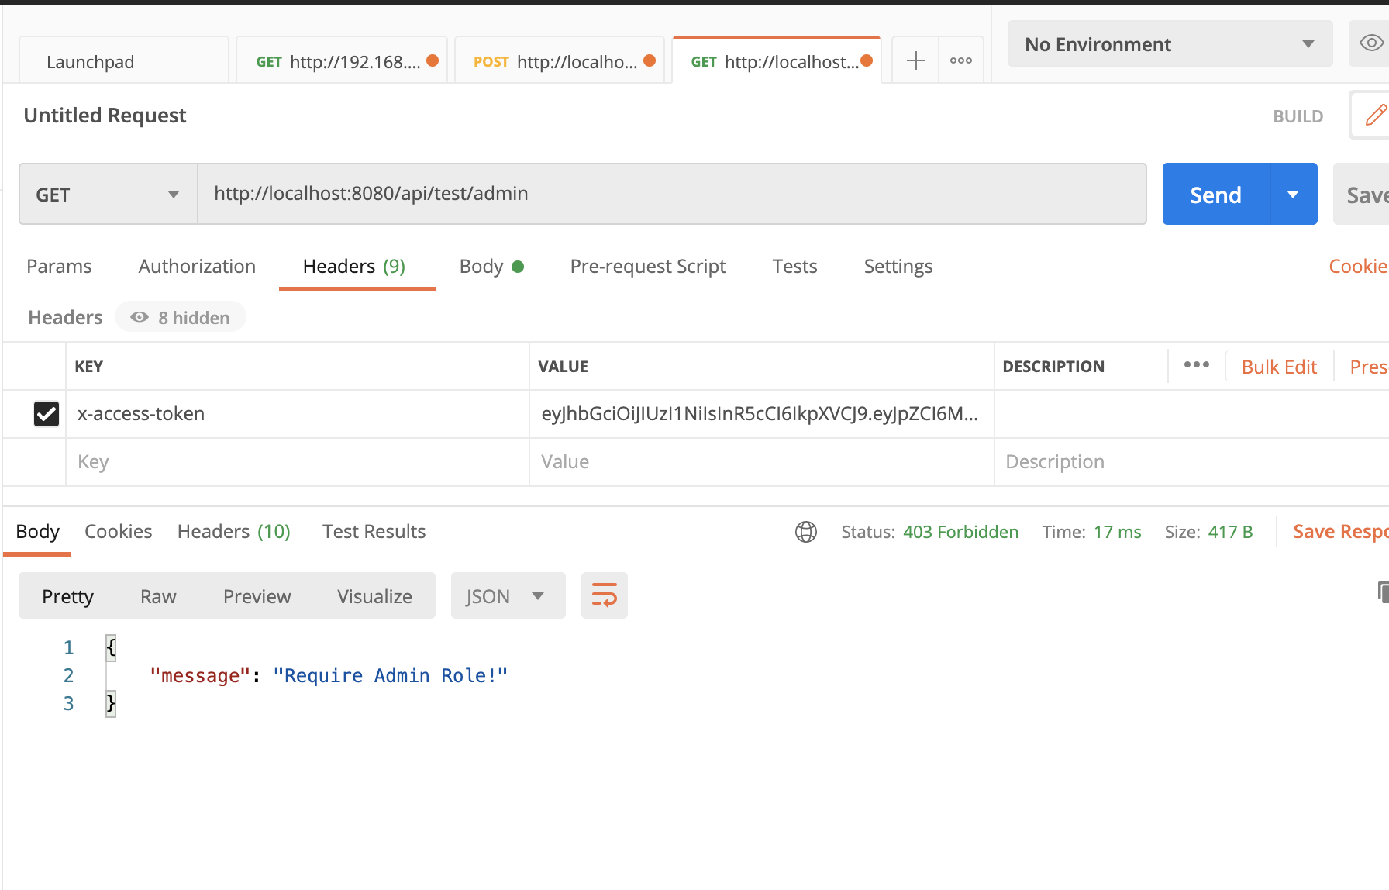
Graduation IN Informatics engineering
5. Postman Testing
Project III
@2020/2021 – Luis Alonso 17506– Backend Node.js, Express, MySQL
- 35 -

Slide 36
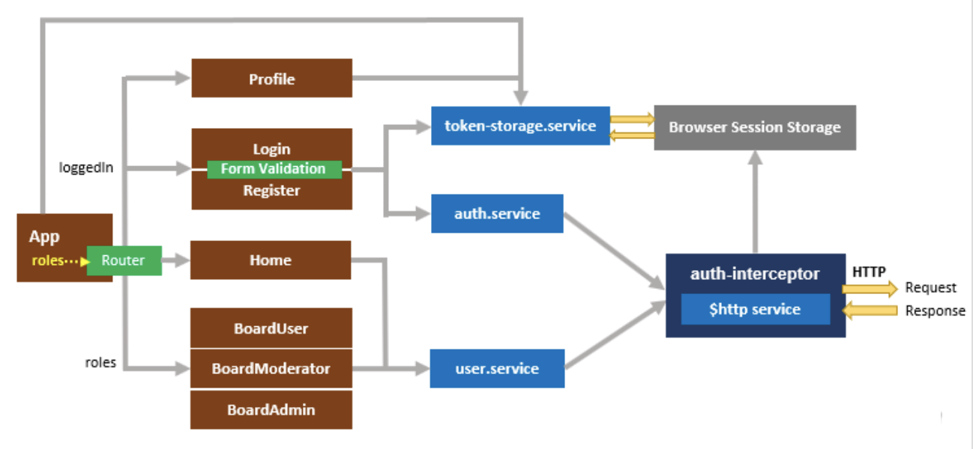
Graduation IN Informatics engineering
6. Angular Implementation v1
Project III
Front End Structure
@2020/2021 – Luis Alonso 17506– Backend Node.js, Express, MySQL, Angular
- 36 -

Slide 37
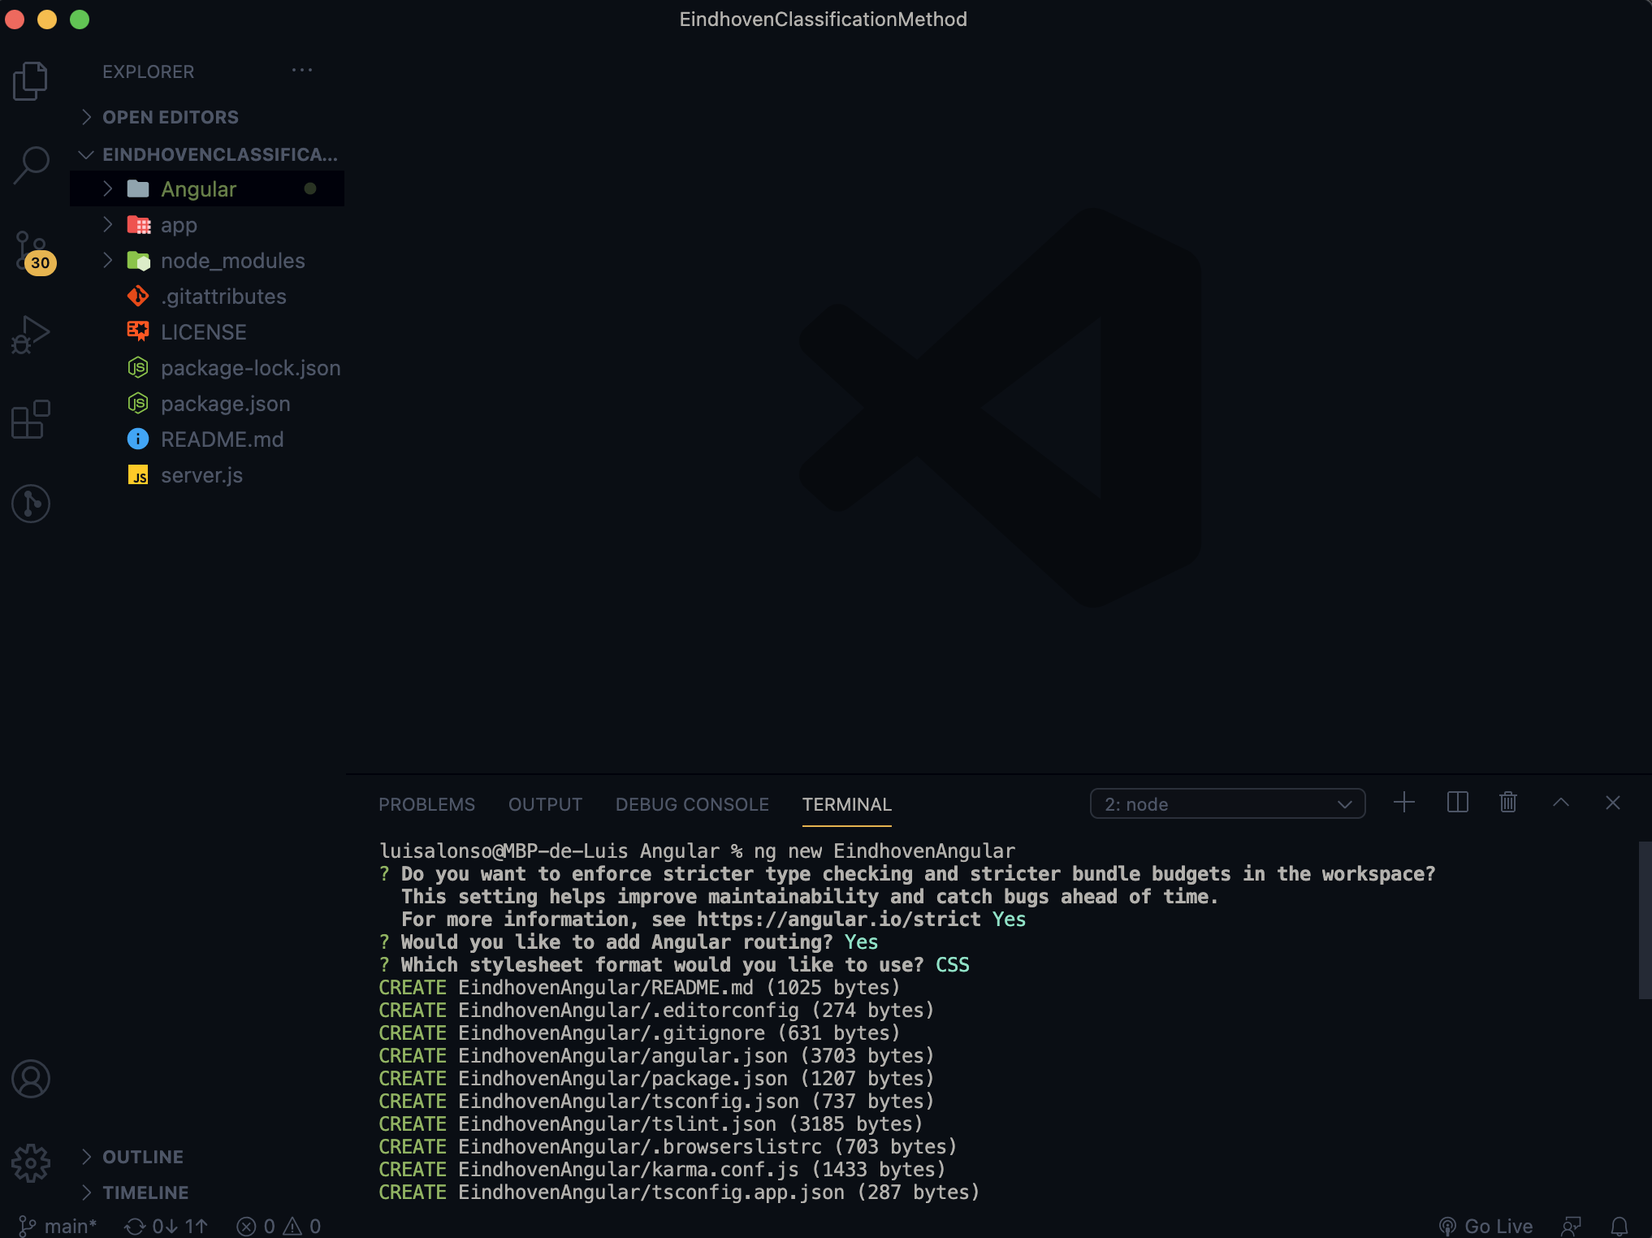
Graduation IN Informatics engineering
6. Angular Implementation v1
Project III
Creating Angular Project
@2020/2021 – Luis Alonso 17506– Backend Node.js, Express, MySQL, Angular
- 37 -

Slide 38
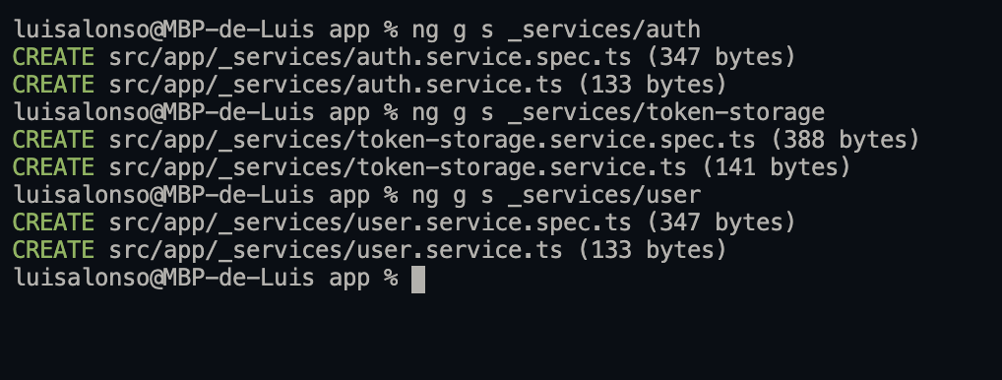
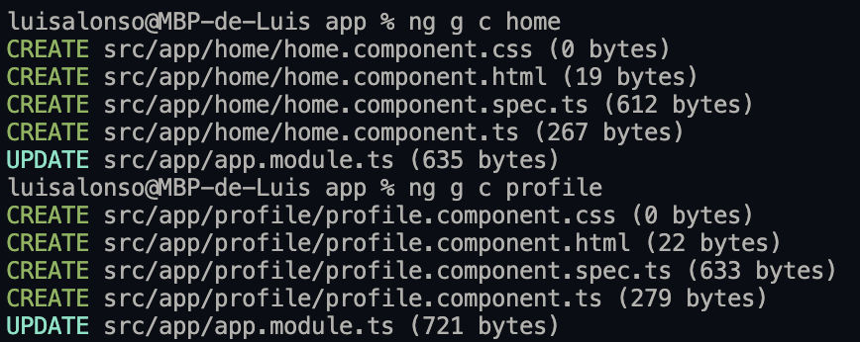
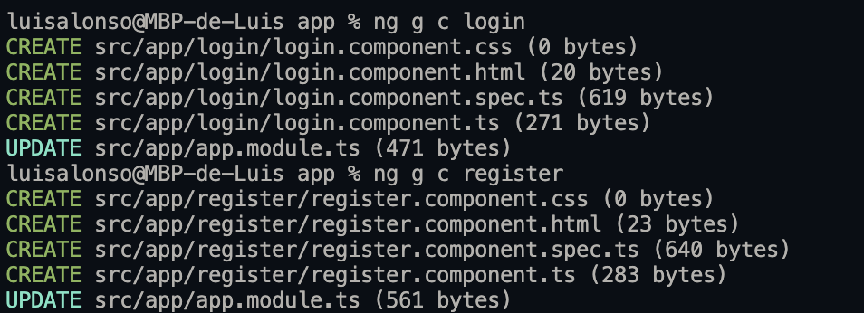
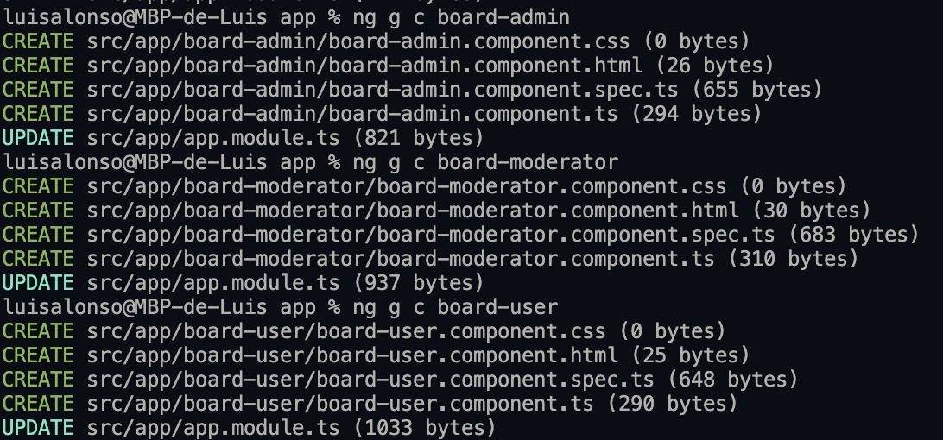
Graduation IN Informatics engineering
6. Angular Implementation v1
Project III
Create Directories with the Angular Commands
@2020/2021 – Luis Alonso 17506– Backend Node.js, Express, MySQL, Angular
- 38 -

Slide 39
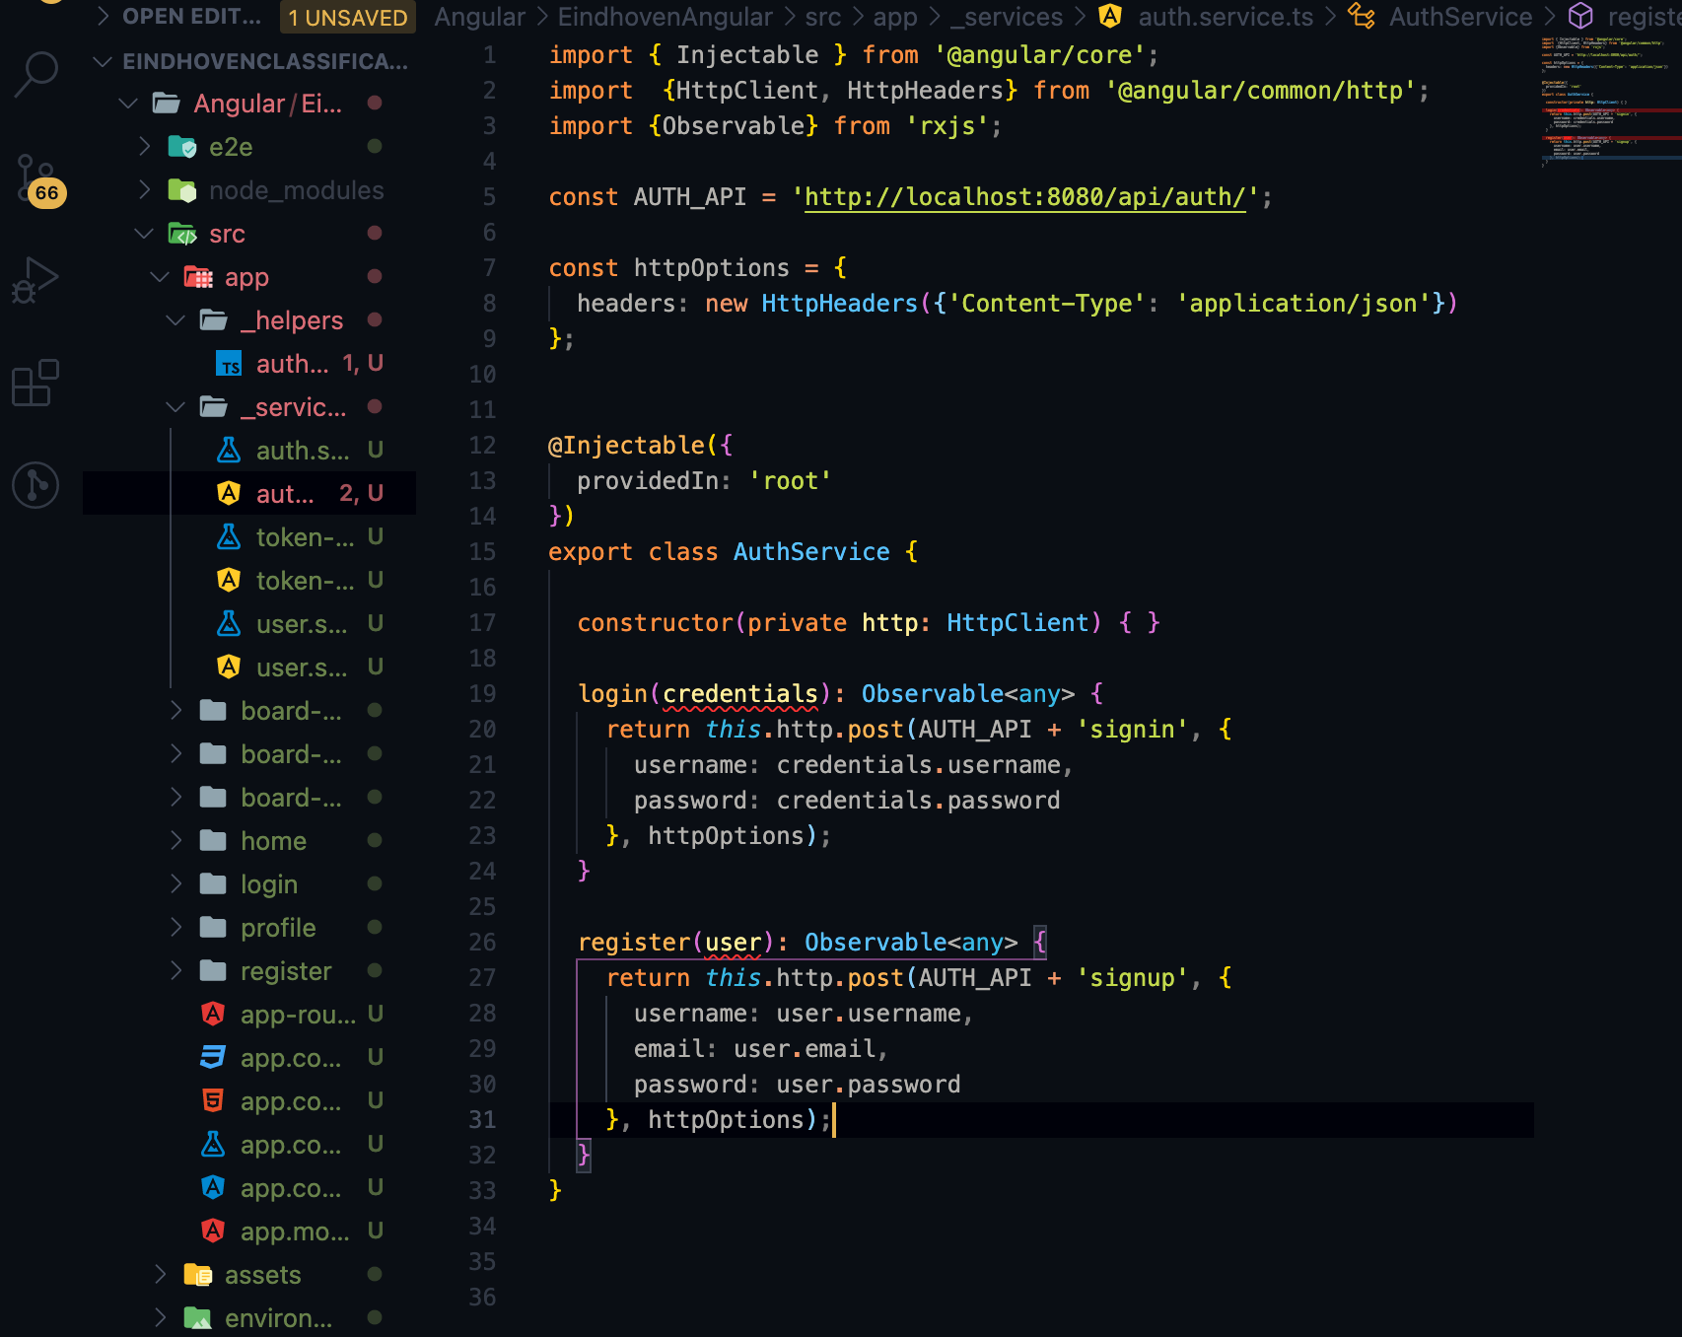
Graduation IN Informatics engineering
6. Angular Implementation v1
Project III
Authentication Service Sends POST requests to back-end.
@2020/2021 – Luis Alonso 17506– Backend Node.js, Express, MySQL, Angular
- 39 -

Slide 40
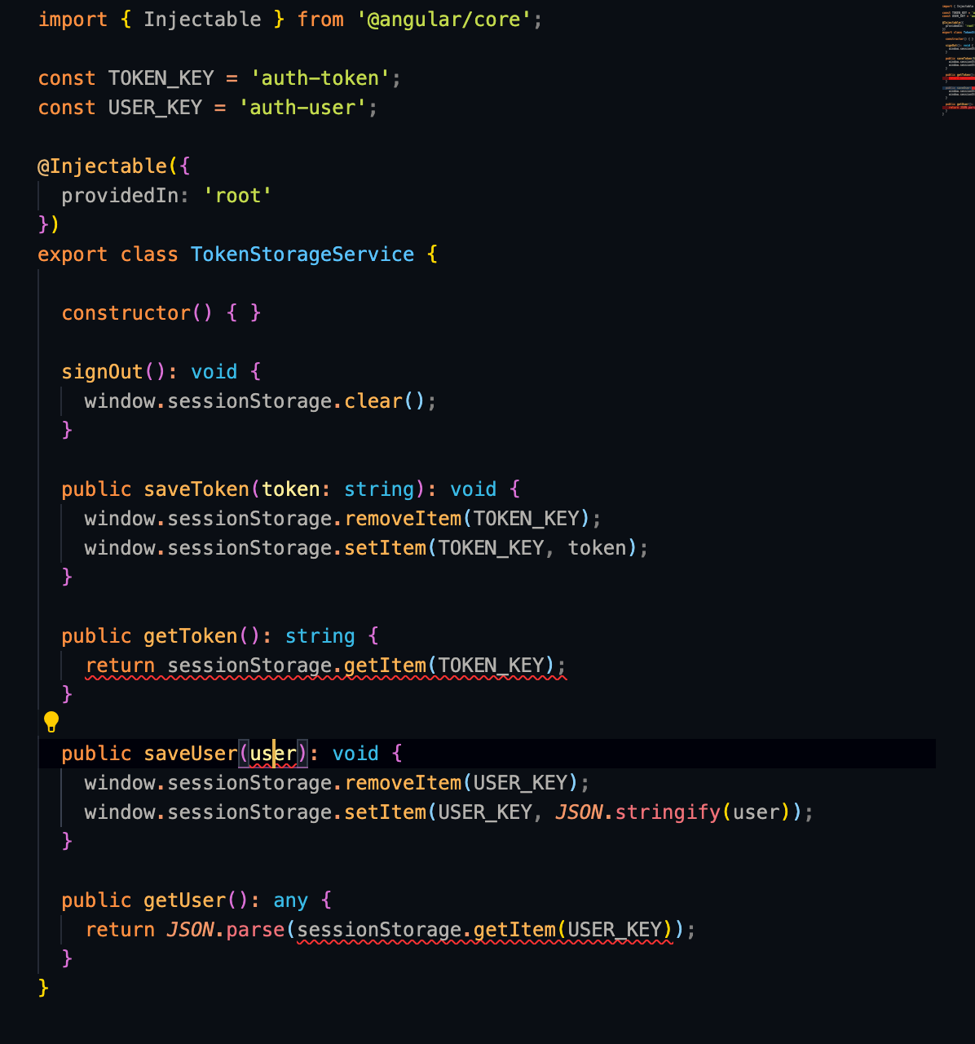
Graduation IN Informatics engineering
6. Angular Implementation v1
Project III
Token Storage Service : TokenStorageService manages the token and user information (username, email, roles) inside Browser’s Session Storage.
@2020/2021 – Luis Alonso 17506– Backend Node.js, Express, MySQL, Angular
- 40 -

Slide 41
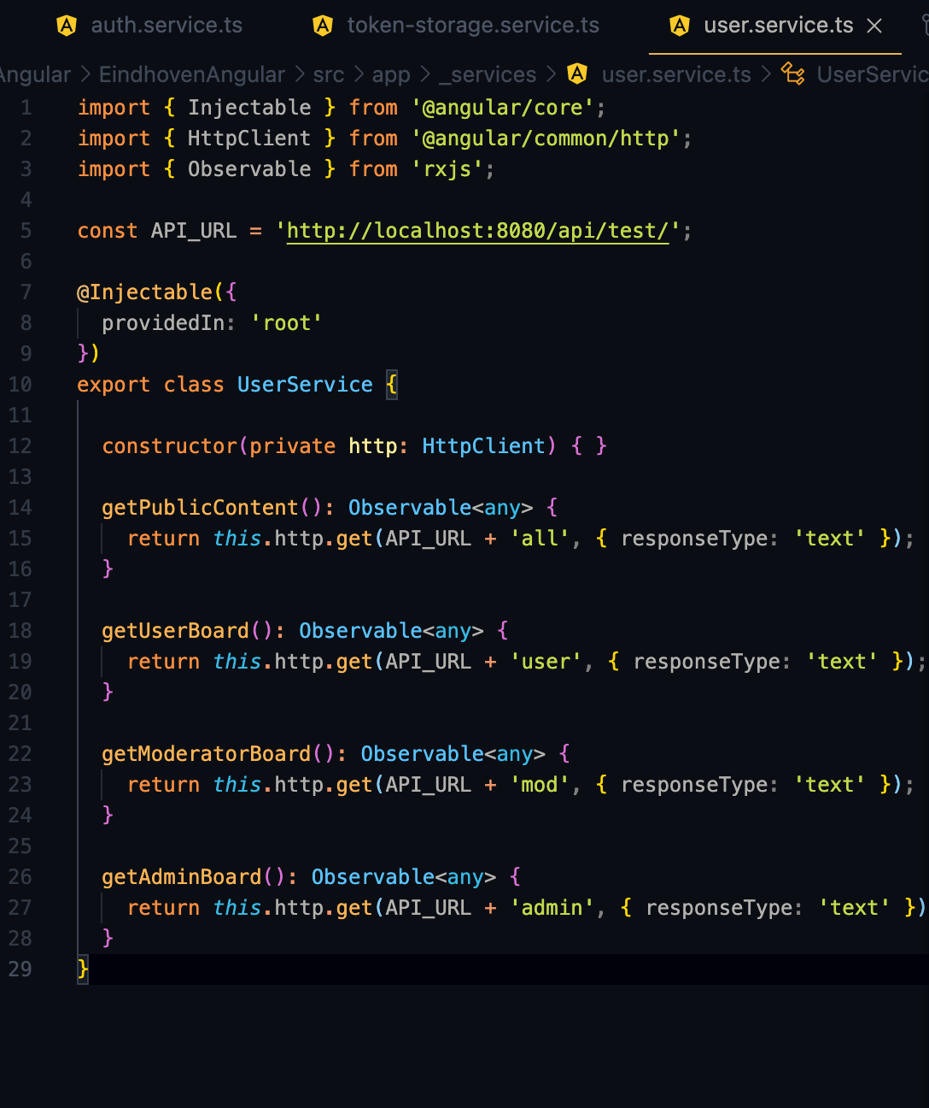
Graduation IN Informatics engineering
6. Angular Implementation v1
Project III
Data Service Using HTTPInterceptor
This service provides methods to access public and protected resources, depending if the user is na Admin, Moderator or just a regular User.
@2020/2021 – Luis Alonso 17506– Backend Node.js, Express, MySQL, Angular
- 41 -

Slide 42
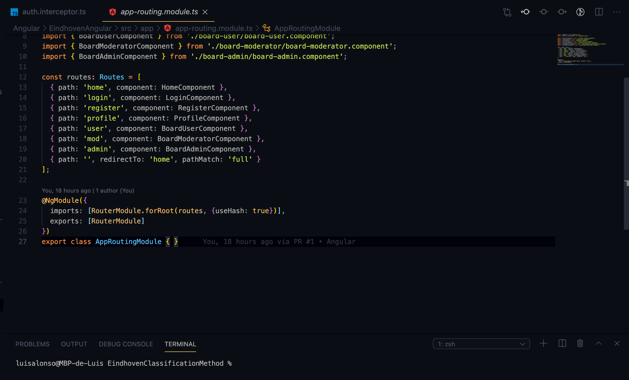
Graduation IN Informatics engineering
6. Angular Implementation v1
Project III
Routing Components
@2020/2021 – Luis Alonso 17506– Backend Node.js, Express, MySQL
- 42 -

Slide 43
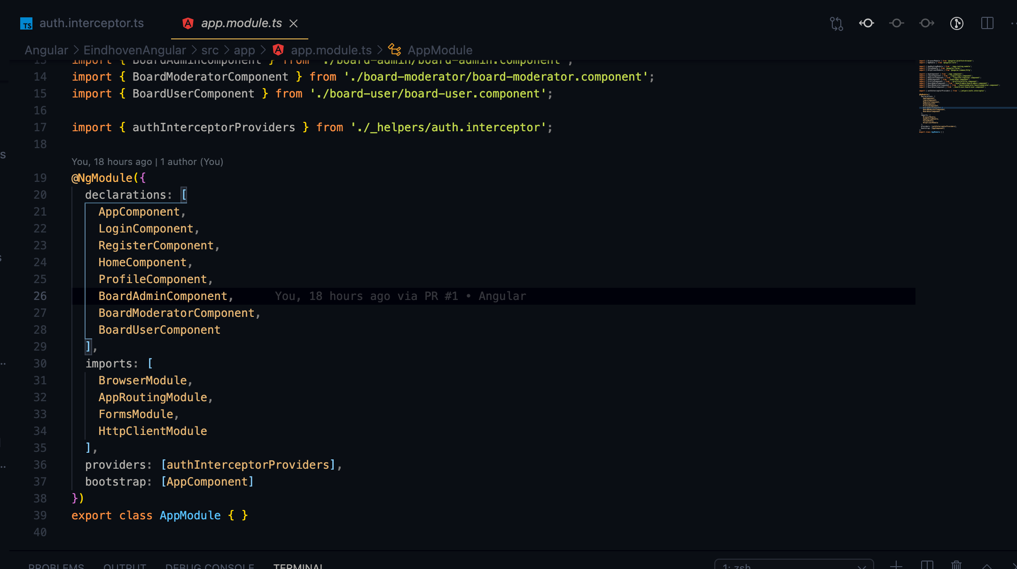
Graduation IN Informatics engineering
6. Angular Implementation v1
Project III
App Modules and Bootstrap
@2020/2021 – Luis Alonso 17506– Backend Node.js, Express, MySQL
- 43 -

Slide 44
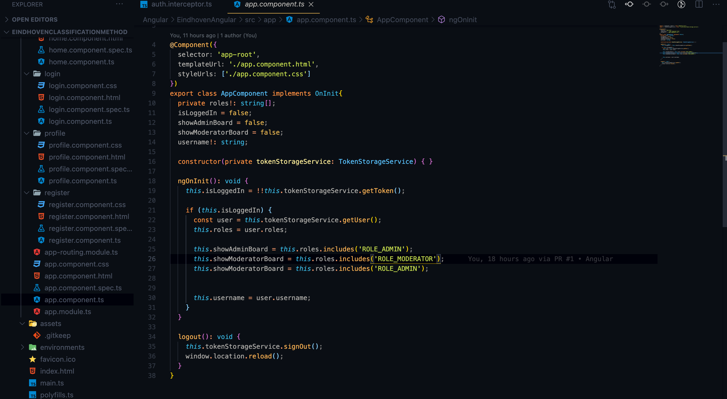
Graduation IN Informatics engineering
6. Angular Implementation v1
Project III
App Component.ts , changes the tabs of the app depending of the role of the user. Also, ends the tokenStorageService.
@2020/2021 – Luis Alonso 17506– Backend Node.js, Express, MySQL
- 44 -

Slide 45
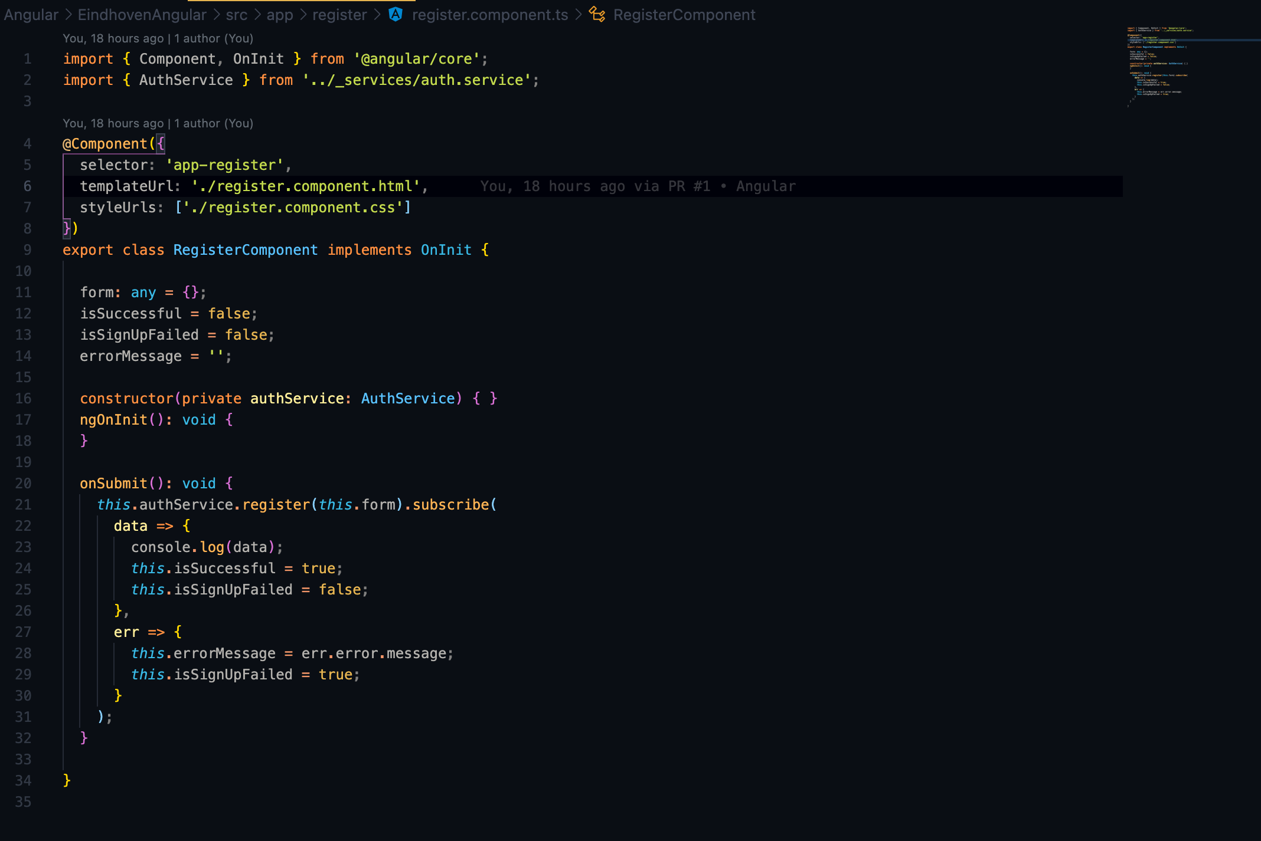
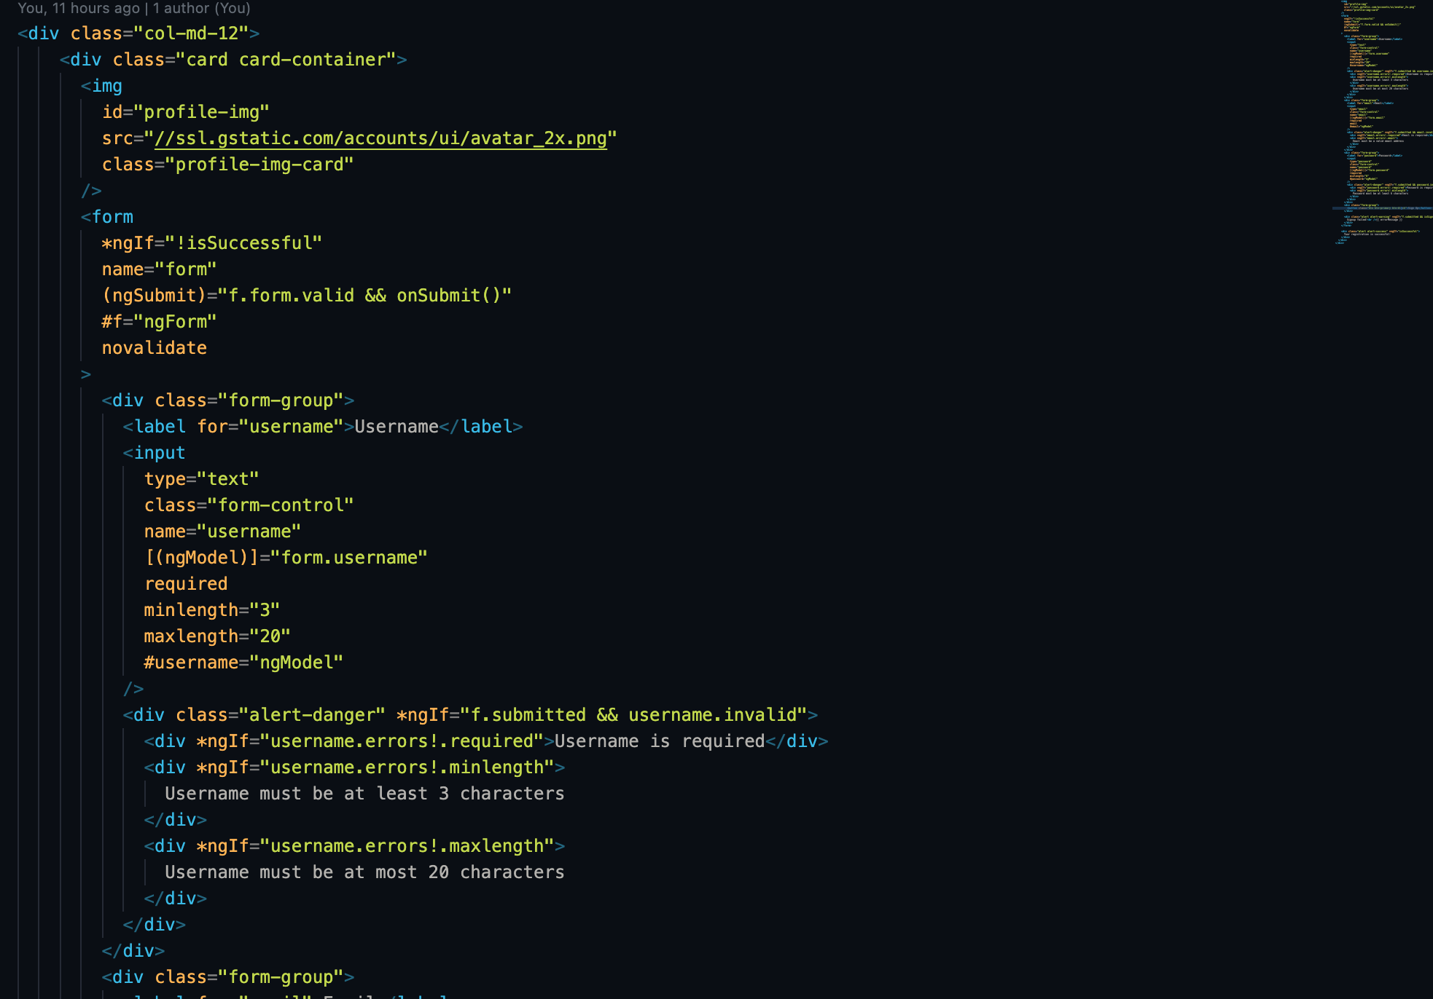
Graduation IN Informatics engineering
6. Angular Implementation v1
Project III
Register.ts and HTML, is has the register functions and the restrictions on the HTML input fields, using the *ngIf statemtents.
@2020/2021 – Luis Alonso 17506– Backend Node.js, Express, MySQL
- 45 -

Slide 46
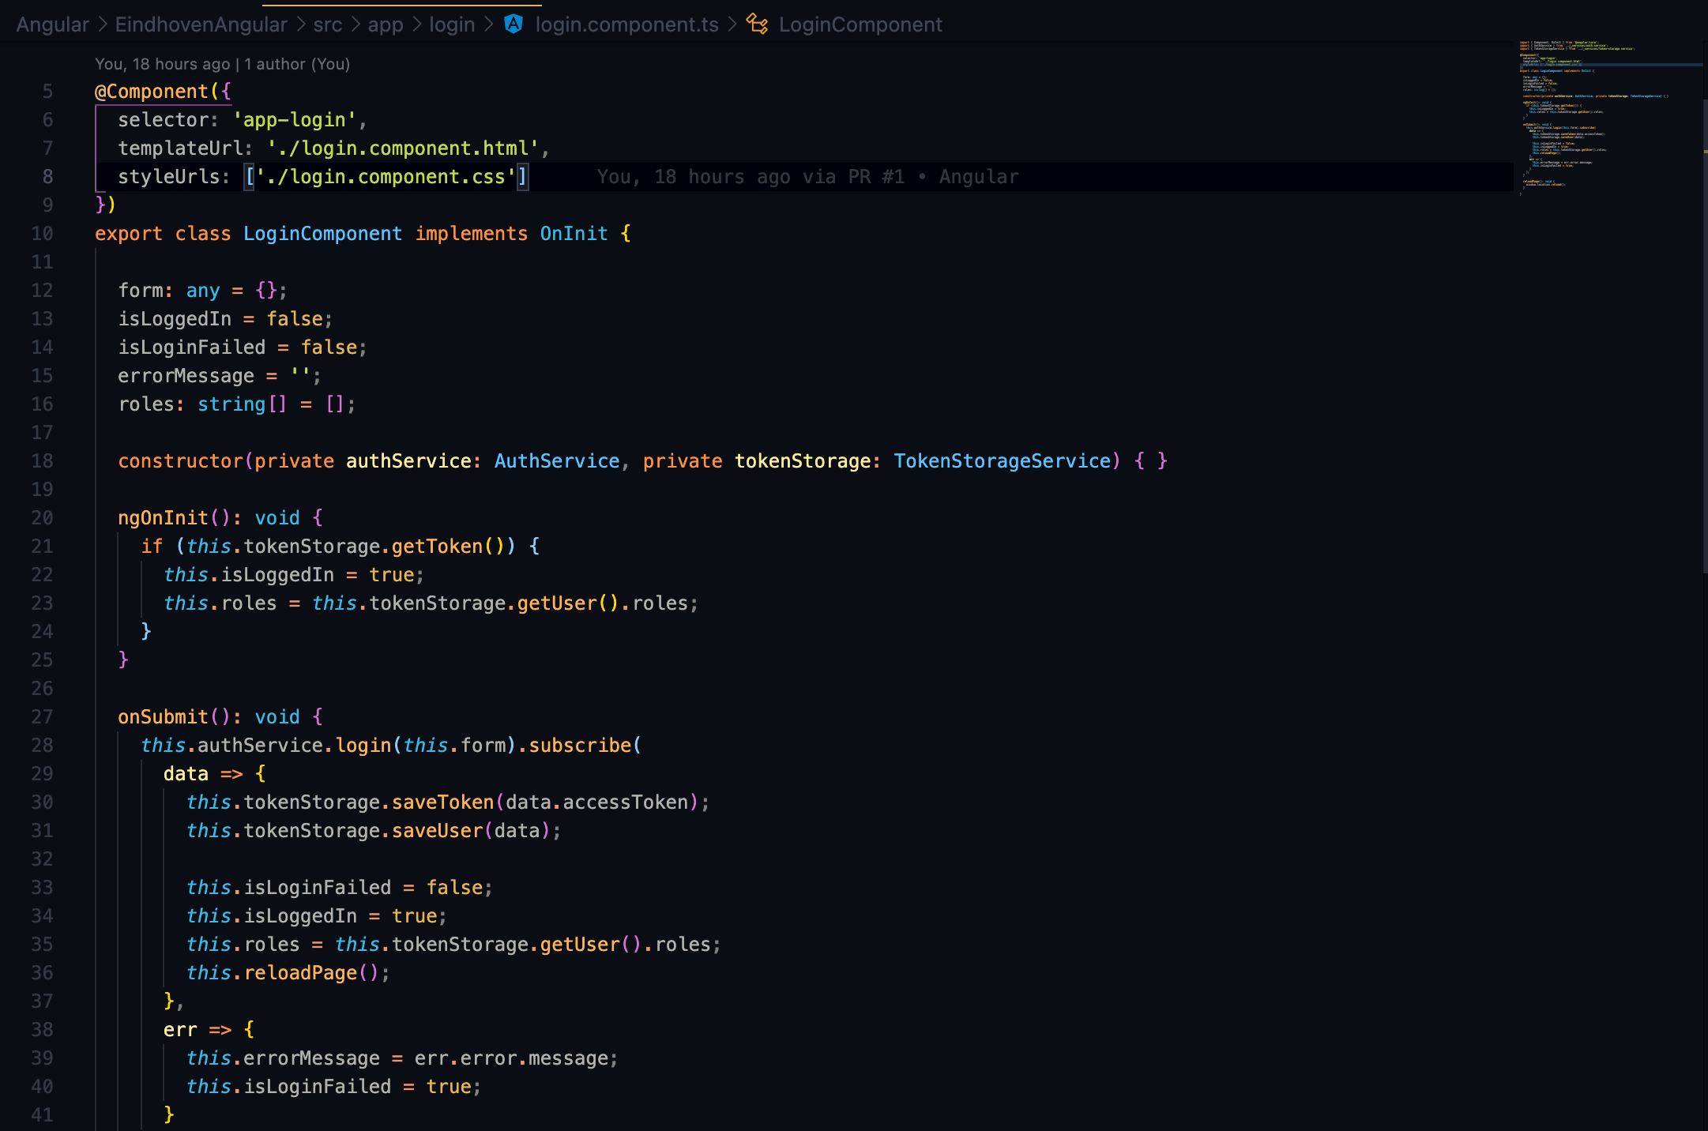

Graduation IN Informatics engineering
6. Angular Implementation v1
Project III
Login.ts and HTML, is has the login functions and the restrictions on the HTML input fields, using the *ngIf statemtents, for exemple, it gives a warning if the username input is void with *ngIf= “f.submitted && username.invalid”.
@2020/2021 – Luis Alonso 17506– Backend Node.js, Express, MySQL
- 46 -

Slide 47


Graduation IN Informatics engineering
6. Angular Implementation v1
Project III
Basic HomeComponent, showing only the public content of the app.
@2020/2021 – Luis Alonso 17506– Backend Node.js, Express, MySQL
- 47 -

Slide 48


Graduation IN Informatics engineering
6. Angular Implementation v1
Project III
Board Admin Page, checks if the user is na Admin,
and provides acess to the Admin content of the app.
@2020/2021 – Luis Alonso 17506– Backend Node.js, Express, MySQL
- 48 -

Slide 49

Graduation IN Informatics engineering
7.1 V2- Use case Diagram
Project III
Use case Diagram
@2020/2021 – Luis Alonso 17506– Backend Node.js, Express, MySQL
- 49 -

Slide 50


Graduation IN Informatics engineering
7.2 V2- EER Diagram
Project III
EER sketch
EER First Version
@2020/2021 – Luis Alonso 17506– Backend Node.js, Express, MySQL
- 50 -

Slide 51

Graduation IN Informatics engineering
7.2 V2- EER Diagram
Project III
EER Final Version
@2020/2021 – Luis Alonso 17506– Backend Node.js, Express, MySQL
- 51 -

Slide 52
Graduation IN Informatics engineering
7. Angular Implementation v1
Project III
Board Admin Page, checks if the user is na Admin,
and provides acess to the Admin content of the app.
@2020/2021 – Luis Alonso 17506– Backend Node.js, Express, MySQL
- 52 -

Slide 53





Graduation IN Informatics engineering
7. Node Implementation v2
Project III
Project Structure
@2020/2021 – Luis Alonso 17506– Backend Node.js, Express, MySQL
- 53 -

Slide 54

Graduation IN Informatics engineering
7. Node Implementation v2
Project III
Db.js -> Connects to MySQL server using the mysql2 db client and executes a query to create the database if it doesn't already exist.
Connects to the database with the Sequelize ORM.
Initializes the Account and RefreshToken models and attaches them to the exported db object.
Defines the one-to-many relationship between accounts and refresh tokens and configures refresh tokens to be deleted when the account they belong to is deleted.
Automatically creates tables in MySQL database if they don't exist by calling await sequelize.sync
@2020/2021 – Luis Alonso 17506– Backend Node.js, Express, MySQL
- 54 -

Slide 55

Graduation IN Informatics engineering
7. Node Implementation v2
Project III
Role.js -> The roles used by the Project.
@2020/2021 – Luis Alonso 17506– Backend Node.js, Express, MySQL
- 55 -

Slide 56

Graduation IN Informatics engineering
7. Node Implementation v2
Project III
Send-email.js -> Uses nodemailer to send the required emails.
@2020/2021 – Luis Alonso 17506– Backend Node.js, Express, MySQL
- 56 -

Slide 57

Graduation IN Informatics engineering
7. Node Implementation v2
Project III
Swagger.js -> The Swagger docs route handler uses the Swagger UI Express module to serve auto-generated Swagger UI documentation based on the swagger.yaml file from the /api-docs path of the api. The route handler is bound to the /api-docs path in the main server.js file.
@2020/2021 – Luis Alonso 17506– Backend Node.js, Express, MySQL
- 57 -

Slide 58

Graduation IN Informatics engineering
7. Node Implementation v2
Project III
Authorize.js -> The authorize middleware can be added to any route to restrict access to the route to authenticated users with specified roles. If the rolesparameter is omitted (i.e. authorize()) then the route will be accessible to all authenticated users regardless of role. It is used by the accounts controller to restrict access to account CRUD routes and revoke token route.
The authorize function returns an array containing two middleware functions:
The first (jwt({ ... })) authenticates the request by validating the JWT access token in the "Authorization" header of the http request. On successful authentication a user object is attached to the req object that contains the data from the JWT token, which in this example includes the user id (req.user.id).
The second authorizes the request by checking that the authenticated account still exists and is authorized to access the requested route based on its role. The second middleware function also attaches the role property and the ownsToken method to the req.userobject so they can be accessed by controller functions.
If either authentication or authorization fails then a 401 Unauthorized response is returned.
@2020/2021 – Luis Alonso 17506– Backend Node.js, Express, MySQL
- 58 -

Slide 59

Graduation IN Informatics engineering
7. Node Implementation v2
Project III
Error-handler.js -> used catch all errors and remove the need for duplicated error handling code throughout the application. It's configured as middleware in the main server.js file.
@2020/2021 – Luis Alonso 17506– Backend Node.js, Express, MySQL
- 59 -

Slide 60

Graduation IN Informatics engineering
7. Node Implementation v2
Project III
Validate-request.js -> The validate request middleware function validates the body of a request against a Joi schema object. It is used by schema middleware functions in controllers to validate the request against the schema for a specific route.
@2020/2021 – Luis Alonso 17506– Backend Node.js, Express, MySQL
- 60 -

Slide 61

Graduation IN Informatics engineering
7. Node Implementation v2
Project III
Account.model.js -> Defines the model of the accounts table in the Mysql Database.The DataTypes.Virtual are sequelize virtual fields used to store values that are not persisted in the database for convenience.
@2020/2021 – Luis Alonso 17506– Backend Node.js, Express, MySQL
- 61 -

Slide 62


Graduation IN Informatics engineering
7. Node Implementation v2
Project III
Account.service.js -> Contains all the business logic for signup and verification using the jwt and the refresh tokens. It countains every service related to the account and the CRUD Methods.
@2020/2021 – Luis Alonso 17506– Backend Node.js, Express, MySQL
- 62 -

Slide 63

Graduation IN Informatics engineering
7. Node Implementation v2
Project III
Register Function -> Registers new users, and if it is the first user being registered
sets the role as Admin.
VerifyEmail Function -> Checks if there is a verificationToken stored, if not, it throws a error message. If the token exists, it updates the verified field and saves.
@2020/2021 – Luis Alonso 17506– Backend Node.js, Express, MySQL
- 63 -

Slide 64

Graduation IN Informatics engineering
7. Node Implementation v2
Project III
Functions related to the User password and the reset token.
@2020/2021 – Luis Alonso 17506– Backend Node.js, Express, MySQL
- 64 -

Slide 65

Graduation IN Informatics engineering
7. Node Implementation v2
Project III
Basic get Functions, the create function for creating new users, after verifying that there is not an account with the same email and the Update account function.
@2020/2021 – Luis Alonso 17506– Backend Node.js, Express, MySQL
- 65 -

Slide 66

Graduation IN Informatics engineering
7. Node Implementation v2
Project III
Refresh Token, password hash and random Token string Functions
@2020/2021 – Luis Alonso 17506– Backend Node.js, Express, MySQL
- 66 -

Slide 67

Graduation IN Informatics engineering
7. Node Implementation v2
Project III
All the send email functions needed by the Project.
@2020/2021 – Luis Alonso 17506– Backend Node.js, Express, MySQL
- 67 -

Slide 68

Graduation IN Informatics engineering
7. Node Implementation v2
Project III
Account.controller.js ->
The accounts controller defines all /accounts routes.
Routes that require authorization include the middleware function authorize() and optionally specify a role, if a role is specified then the route is restricted to users in that role, otherwise the route is restricted to all authenticated users regardless of role. The auth logic is located in the authorize middleware.
Some functions have an extra custom authorization check to prevent non-admin users from accessing accounts other than their own.
@2020/2021 – Luis Alonso 17506– Backend Node.js, Express, MySQL
- 68 -

Slide 69

Graduation IN Informatics engineering
7. Node Implementation v2
Project III
Token related functions
@2020/2021 – Luis Alonso 17506– Backend Node.js, Express, MySQL
- 69 -

Slide 70


Graduation IN Informatics engineering
7. Node Implementation v2
Project III
@2020/2021 – Luis Alonso 17506– Backend Node.js, Express, MySQL
- 70 -

Slide 71


Graduation IN Informatics engineering
7. Node Implementation v2
Project III
Each schema validation function defines a schema for the request body using the Joi library and calls validateRequest(req, next, schema) to ensure the request body is valid. If validation succeeds the request continues to the next middleware function (the route function), otherwise an error is returned with details of why validation failed.
@2020/2021 – Luis Alonso 17506– Backend Node.js, Express, MySQL
- 71 -

Slide 72

Graduation IN Informatics engineering
7. Node Implementation v2
Project III
Category.model.js -> Defines the database model for the Categories. . The relations are defined in the database wrapper.
@2020/2021 – Luis Alonso 17506– Backend Node.js, Express, MySQL
- 72 -

Slide 73

Graduation IN Informatics engineering
7. Node Implementation v2
Project III
Process.model.js -> Defines the database model for the Process Table. The relations are defined in the database wrapper.
@2020/2021 – Luis Alonso 17506– Backend Node.js, Express, MySQL
- 73 -

Slide 74

Graduation IN Informatics engineering
7. Node Implementation v2
Project III
Config.json -> It specifies the database connection, the secret for the jwts, and the email details using SMTP for nodemailer.
@2020/2021 – Luis Alonso 17506– Backend Node.js, Express, MySQL
- 74 -

Slide 75

Graduation IN Informatics engineering
7. Node Implementation v2
Project III
Package.json -> All the dependencies used.
@2020/2021 – Luis Alonso 17506– Backend Node.js, Express, MySQL
- 75 -

Slide 76

Graduation IN Informatics engineering
7. Node Implementation v2
Project III
Server.js -> The server.js file is the entry point into the api. It configures application middleware, binds controllers to routes and starts the Express web server for the api.
@2020/2021 – Luis Alonso 17506– Backend Node.js, Express, MySQL
- 76 -

Slide 77

Graduation IN Informatics engineering
7. Database v2
Project III
Account_Process table
@2020/2021 – Luis Alonso 17506– Backend Node.js, Express, MySQL
- 77 -

Slide 78

Graduation IN Informatics engineering
7. Database v2
Project III
Account Table and Fields
@2020/2021 – Luis Alonso 17506– Backend Node.js, Express, MySQL
- 78 -

Slide 79

Graduation IN Informatics engineering
7. Database v2
Project III
refreshTokens Table
@2020/2021 – Luis Alonso 17506– Backend Node.js, Express, MySQL
- 79 -

Slide 80

Graduation IN Informatics engineering
7. Database v2
Project III
Categories Table
@2020/2021 – Luis Alonso 17506– Backend Node.js, Express, MySQL
- 80 -

Slide 81

Graduation IN Informatics engineering
7. Database v2
Project III
Process_Category Table
@2020/2021 – Luis Alonso 17506– Backend Node.js, Express, MySQL
- 81 -

Slide 82

Graduation IN Informatics engineering
7. Database v2
Project III
Processes Table
@2020/2021 – Luis Alonso 17506– Backend Node.js, Express, MySQL
- 82 -

Slide 83


Graduation IN Informatics engineering
8. Angular Implementation v2
Project III
@2020/2021 – Luis Alonso 17506– Backend Node.js, Express, MySQL
- 83 -

Slide 84

Graduation IN Informatics engineering
8. Angular Implementation v2
Project III
Email for account verification
@2020/2021 – Luis Alonso 17506– Backend Node.js, Express, MySQL
- 84 -

Slide 85

Graduation IN Informatics engineering
7. Node Implementation v2
Project III
Account created at the database
@2020/2021 – Luis Alonso 17506– Backend Node.js, Express, MySQL
- 85 -

Slide 86

Graduation IN Informatics engineering
8. Angular Implementation v2
Project III
Forgot Password Page
@2020/2021 – Luis Alonso 17506– Backend Node.js, Express, MySQL
- 86 -

Slide 87

Graduation IN Informatics engineering
8. Angular Implementation v2
Project III
Password Recovery Email
@2020/2021 – Luis Alonso 17506– Backend Node.js, Express, MySQL
- 87 -

Slide 88

Graduation IN Informatics engineering
8. Angular Implementation v2
Project III
Password Reset
@2020/2021 – Luis Alonso 17506– Backend Node.js, Express, MySQL
- 88 -

Slide 89


Graduation IN Informatics engineering
8. Angular Implementation v2
Project III
@2020/2021 – Luis Alonso 17506– Backend Node.js, Express, MySQL
- 89 -

Slide 90


Graduation IN Informatics engineering
8. Angular Implementation v2
Project III
Moderator Page
Admin Page
@2020/2021 – Luis Alonso 17506– Backend Node.js, Express, MySQL
- 90 -

Slide 91

Graduation IN Informatics engineering
8. Angular Implementation v2
Project III
Manage all accounts as Admin
@2020/2021 – Luis Alonso 17506– Backend Node.js, Express, MySQL
- 91 -

Slide 92

Graduation IN Informatics engineering
8. Angular Implementation v2
Project III
Edit account as Admin
@2020/2021 – Luis Alonso 17506– Backend Node.js, Express, MySQL
- 92 -

Slide 93

Graduation IN Informatics engineering
8. Angular Implementation v2
Project III
Flowchart Editor
@2020/2021 – Luis Alonso 17506– Backend Node.js, Express, MySQL
- 93 -

Slide 94

Graduation IN Informatics engineering
8. Angular Implementation v2
Project III
Flowchart.module.ts
@2020/2021 – Luis Alonso 17506– Backend Node.js, Express, MySQL
- 94 -

Slide 95

Graduation IN Informatics engineering
8. Angular Implementation v2
Project III
Flowchart.component.ts
@2020/2021 – Luis Alonso 17506– Backend Node.js, Express, MySQL
- 95 -

Slide 96

Graduation IN Informatics engineering
8. Angular Implementation v2
Project III
Flowchart.component.spec.ts
@2020/2021 – Luis Alonso 17506– Backend Node.js, Express, MySQL
- 96 -

Slide 97


Graduation IN Informatics engineering
8. Angular Implementation v2
Project III
Flowchart.component.html
Flowchart.component.css
@2020/2021 – Luis Alonso 17506– Backend Node.js, Express, MySQL
- 97 -

Slide 98

Graduation IN Informatics engineering
8. Angular Implementation v2
Project III
Flowchart-routing.module.ts
@2020/2021 – Luis Alonso 17506– Backend Node.js, Express, MySQL
- 98 -

Slide 99


Graduation IN Informatics engineering
8. Angular Implementation v2
Project III
Diagram.component.ts
@2020/2021 – Luis Alonso 17506– Backend Node.js, Express, MySQL
- 99 -

Slide 100



Graduation IN Informatics engineering
8. Angular Implementation v2
Project III
Diagram.component.spec.ts
@2020/2021 – Luis Alonso 17506– Backend Node.js, Express, MySQL
- 100 -

Slide 101

Graduation IN Informatics engineering
8. Angular Implementation v2
Project III
RX.ts
@2020/2021 – Luis Alonso 17506– Backend Node.js, Express, MySQL
- 101 -

Slide 102


Graduation IN Informatics engineering
8. Angular Implementation v2
Project III
Package.json
@2020/2021 – Luis Alonso 17506– Backend Node.js, Express, MySQL
- 102 -

Slide 103

Graduation IN Informatics engineering
9. GitHub Repository
Project III
@2020/2021 – Luis Alonso 17506– Backend Node.js, Express, MySQL
- 103 -

Slide 104

Graduation IN Informatics engineering
9. GitHub Repository
Project III
@2020/2021 – Luis Alonso 17506– Backend Node.js, Express, MySQL
- 104 -

Slide 105

Graduation IN Informatics engineering
9. GitHub Repository Graph
Project III
@2020/2021 – Luis Alonso 17506– Backend Node.js, Express, MySQL
- 105 -

Slide 106

Graduation IN Informatics engineering
9. GitHub Repository Graph
Project III
@2020/2021 – Luis Alonso 17506– Backend Node.js, Express, MySQL
- 106 -

Slide 107
Graduation IN Informatics engineering
10- What to do next?
Project III
In this PowerPoint i have 2 Versions of the Project. On the V1 i have the basic implementation of the stack, but due to some problems with the Email/JWT part i have decided to continue in another direction, creating the V2. This second version is the most complete and functional one, but i decided not to delete the V1 from the repository allowing me to show the evolution step by step of what i have done. To complete this Project it is still needed to implement the Process and Category Part of the ECM on Angular, and the API part of the same requirement on Node.
@2020/2021 – Luis Alonso 17506– Backend Node.js, Express, MySQL
- 107 -

Slide 108
Graduation IN Informatics engineering
11. Bibliography and Web References
Project III
https://pplware.sapo.pt/tutoriais/node-js-aprenda-criar-um-servidor-web-menos-1-minuto/
https://developer.mozilla.org/pt-PT/docs/Web/HTTP/CORS
https://www.luiztools.com.br/post/tutorial-de-crud-com-node-js-sequelize-e-mysql/
https://www.tutorialspoint.com/expressjs/expressjs_overview.htm
https://expressjs.com
https://searchoracle.techtarget.com/definition/MySQL
http://expressjs.com/en/resources/middleware/body-parser.html
https://bezkoder.com/node-js-jwt-authentication-mysql/
https://sequelize.org
https://jwt.io
https://github.com/dcodeIO/bcrypt.js#usage---async
https://nodejs.org/en/
@2020/2021 – Luis Alonso 17506– Backend Node.js, Express, MySQL
- 108 -

Slide 109
Graduation IN Informatics engineering
Backend Node.js, Express, MySQL
■ Course Unit: Project III
Luís Alonso 17506
■ Coordinator: Prof. Doctor Jorge Ribeiro
Instituto Politécnico de Viana do Castelo
Escola Superior de Tecnologia e Gestão
www.ipvc.pt
School Year: 2020/2021

